Slide 1
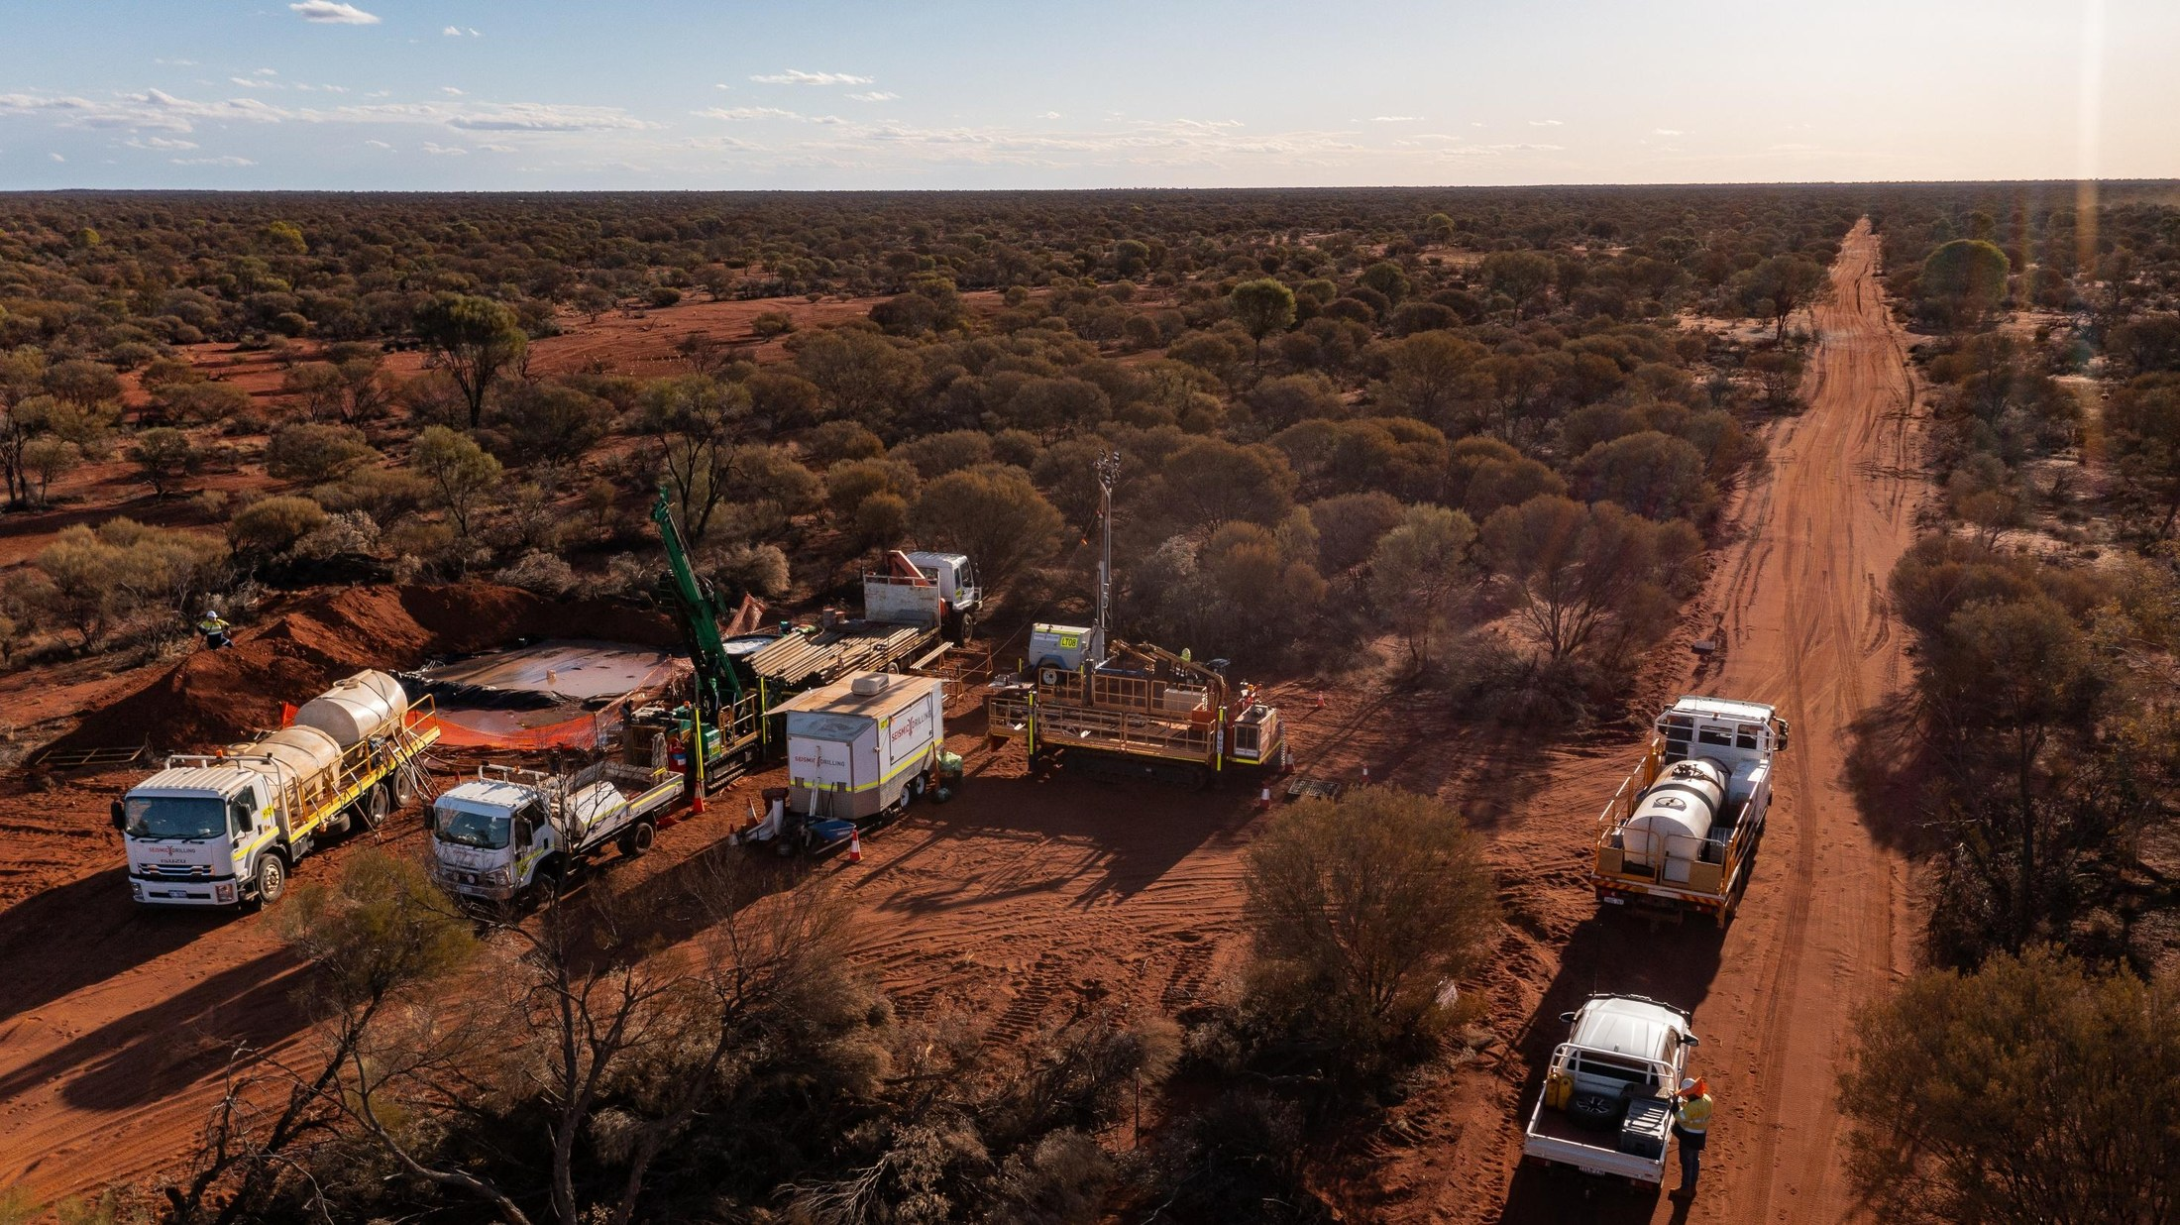

ASX: GML | RESOURCES RISING STARS PRESENTATION | SEPTEMBER 2026
Major Discovery Underway
Yandal — building Australia's next multi-million-ounce gold camp
41m @ 2.0 g/t Au
13km+
400koz
incl. 9m @ 7.5 g/t Au.
Cowza RC discovery (CZRC057)
of mineralised strike on the Celia Shear Zone.
Inferred Mineral Resource — open at depth.
Richard Pugh, Chief Executive Officer
Notes:
Cover. Theme: the discovery phase begins — the Cowza RC result validates the targeting model built over the past twelve months.

Slide 2
Important Information and Disclaimer
2
2
Forward Looking Statements
This presentation has been prepared by Gateway Mining Ltd (GML). The information contained in this presentation is a professional opinion only and is given in good faith. Certain information in this document has been derived from third parties and through GML has no reason to believe that it is not accurate, reliable or complete, it has not been independently audited or verified by GML.
This presentation is in summary form and does not purport to be all inclusive or complete. Recipients should conduct their own investigations and perform their own analysis in order to satisfy themselves as to the accuracy and the completeness of the information, statements and opinions contained.
This is for information purposes only. Neither this nor the information contained in it constitutes an offer, invitation, solicitation or recommendation in relation to the purchase or sale of GML shares in any jurisdiction. This does not constitute investment advice and has been prepared without taking into account the recipient’s investment objectives, financial circumstances or particular needs and the opinions and recommendations in this presentation are not intended to represent recommendations of particular investments to particular persons. Recipients should seek professional advice when deciding if an investment is appropriate. All securities transactions involve risks, which include (among others) the risk of adverse or unanticipated market, financial or political developments.
To the fullest extent permitted by law, GML, its officers, employees, related bodies corporate, agents and advisors do not make any representations or warranty, express or implied, as to the currency, accuracy, reliability or completeness of any information, statements, opinions, estimated, forecasts or other representations contained in this presentation. No responsibility for any errors or omissions from this arising out of negligence or otherwise is accepted.
Any forward looking statements included in this document involve subjective judgment and analysis and are subject to uncertainties, risks and contingencies, many of which are outside the control of, and may be unknown to, GML. In particular they speak only as of the date of this document, they assume the success of GML’s strategies, and they are subject to significant regulatory business, competitive and economic uncertainties and risks. Actual events may vary materially from the forward-looking statements and the assumptions on which the forward-looking statements are based. Recipients of this document are cautioned to not place undue reliance on such forward-looking statements.
Important Information
Nothing in this material should be construed as either an offer to sell or a solicitation of an offer to buy or sell securities.
Recipients should conduct their own investigations and perform their own analysis in order to satisfy themselves as to the accuracy and the completeness of the information, statements and opinions contained.
By receiving the Presentation, you acknowledge and represent to the Company that you have read, understood and accepted the terms of this disclaimer. This Presentation is not a prospectus, product disclosure statement or other offering document under Australian law or any other law (and will not be lodged with the Australian Securities and Investments Commission (ASIC) or any other foreign regulator) and is not, and does not constitute, an invitation or offer of securities for subscription, purchase or sale in any jurisdiction. In particular, this Presentation does not constitute an invitation or offer of securities for subscription, purchase or sale in the United States or any other jurisdiction in which such an offer would be illegal. The securities referred to in this Presentation have not been, and will not be, registered under the US Securities Act of 1933 as amended or the securities laws of any state or other jurisdiction of the United States and may not be offered or sold, directly or indirectly in the United States.
The presentation has been authorised for release by the Executive Chairman of the Company.
Competent Person Statement
The information in this presentation that relates to Exploration Results and Mineral Resources has been extracted from various GML ASX announcements and are available to view on the GML website at www.gatewaymining.com.au or through the ASX website at www.asx.com.au (using ticker code “GML”).
GML confirms that it is not aware of any new information or data that materially affects the information included in the original market announcementand that all material assumptions and technical parameters underpinning the Mineral Resources in the relevant market announcement continue to apply and have not materially changed. The Company confirms that the form and context in which the Competent Person’s findings are presented have not been materially modified from the original market announcement.

Slide 3

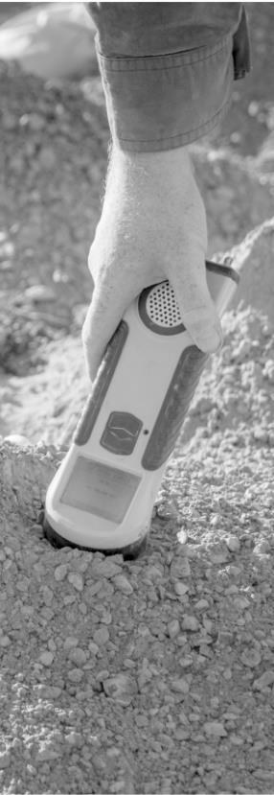
BOARD & MANAGEMENT
The Team That Identified, Acquired and Advanced Yandal
Andrew Bray
15+ years in the formation, financing and development of natural resources companies including Strickland Metals, Silver Mines and Futura Resources. Former CEO of Strickland Metals (previous owner of the Yandal Gold Project).
Executive Chairman
Richard Pugh
20+ years of geology experience across several ASX mineral exploration companies. Former Executive Technical Director, Strickland Metals.
Chief Executive Officer
Anthony McClure
30+ years of technical, management and financial experience in the resources sector worldwide. Current Chair of Strickland Metals; former director of Silver Mines, Bolnisi Gold, Nickel Mines, European Gas and Santana Minerals.
Non-Executive Director
David Morgan
Mining and mechanical engineer with 40+ years in Australia and Africa, including Rio Tinto, Macmahon and WMC Resources. Former GM at Equigold and Sundance Resources; former director of Discovex and Strickland Metals; current NED of Nagambie Resources.
Non-Executive Director
David Crook
Geologist and company director with 40+ years’ experience. Inaugural Managing Director of Pioneer Resources; current Managing Director of Tyranna Resources.
Non-Executive Director
21

Slide 4
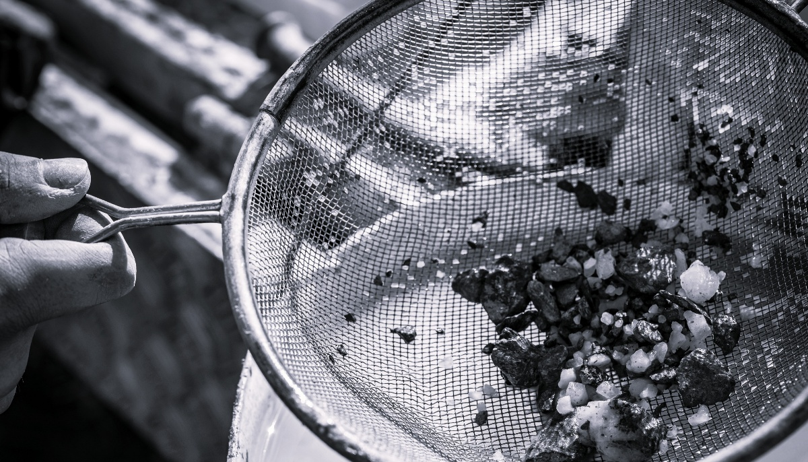



Corporate Summary
CAPITAL STRUCTURE (as at 4 September)
ASX Ticker | GML
Shares on issue | 2,322,814,859
Options on issue¹ | 91,558,083
Performance Rights (12.5c, 17.5c and 25c) | 72,300,000
Cash and liquids² | $15.1M
Placement Completed September Quarter³ | $45M
Share Price | $0.096
Market Capitalisation | ~$223M
71,558,083 options expiry 15/12/2026 at $0.033 per option and 20,000,000 options expiry 2/10/2028 at $0.10 per option.
Cash balance and liquids as at 30 June 2026.
Please refer to ASX announcement dated 9 September 2026.
DIRECTORS & MANAGEMENT
Andrew Bray | Executive Chairman
Anthony McClure | Non-Executive Director
David Crook | Non-Executive Director
David Morgan | Non-Executive Director
Richard Pugh | Chief Executive Officer
Kar Chua | Company Secretary
MAJOR SHAREHOLDERS
Strickland Metals Limited | 12.9%
L11 Capital Pty Ltd | 9.8%
Top 20 | 52.0%
Directors (Directly & Indirectly) | 10.3%
4
Notes:
4

Slide 5
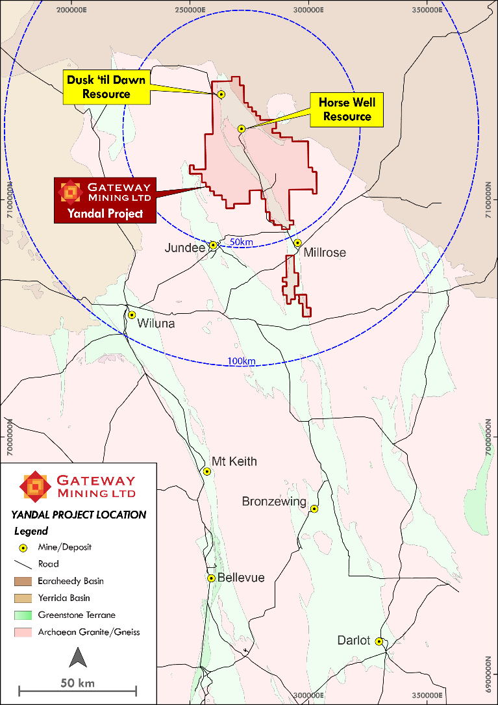
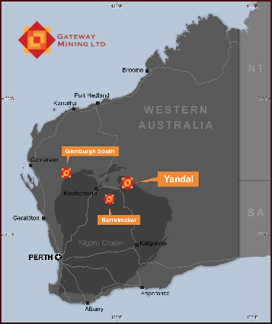
YANDAL GOLD PROJECT
Key Project Areas
Within 50km of Northern Star’s Yandal Operations Centre.
>400koz Mineral Resource Estimate.¹
1. Refer to Appendix A for further details regarding Yandal Mineral Resource Estimate.

Slide 6



THE PAST TWELVE MONTHS
Foundations Laid, Targets Defined, Drilling Underway
Since the Yandal acquisition and management change in mid-2025, Gateway has run a systematic, belt-scale exploration program
WORK COMPLETED
GML SHARE PRICE (A$) — JULY 2025 TO SEPTEMBER 2026
>160,000m
of aircore drilling across the belt
>20,000
multi-element drill samples analysed
Belt-scale
magnetic and gravity data processed to map the key mineralised structures
Last price A$0.096 (4 September 2026)..
OUTCOMES
2 gold systems
4 orogenic targets
3 Au–Ag targets
RC + diamond
Orogenic gold and gold–silver “splay structure” mineralisation.
Cowza, Haflinger, Celia South and Horse Well.
Great Western, Great Western South and Dusk 'til Dawn.
RC drilling underway on priority orogenic targets; diamond rigs arrive this month.
5

Slide 7
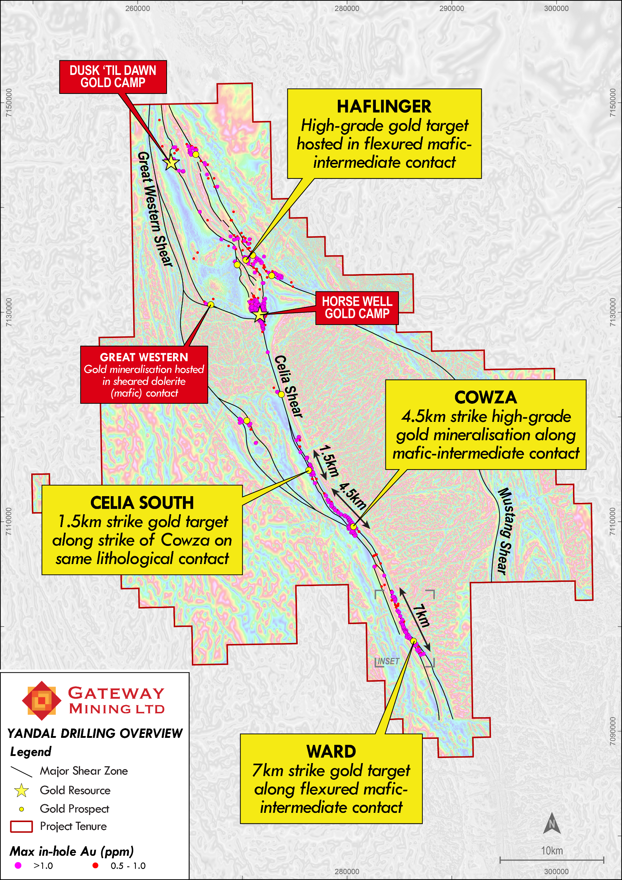
Project Overview
70km of prospective greenstone belt.
Orogenic Gold Targets
  Significant gold mineralisation based on four key factors:
    Mafic-intermediate contact - creates the perfect rheological contrast for significant gold mineralisation to be deposited.
    Northeast trending structures – creating zones of dilation required for hydrothermal gold bearing fluids to infiltrate.
    Zones of de-magnetization – evidence of magnetic destruction of host rocks as part of the hydrothermal gold system.
    Deep seated basinal structure – Celia Shear Corridor.
Gold-Silver ‘Splay Structure’ Targets
  Positioned along regional ‘splay structures’ and associated ‘late intrusions’.
    Great Western
    Dusk ‘til Dawn
    Great Western South

Slide 8
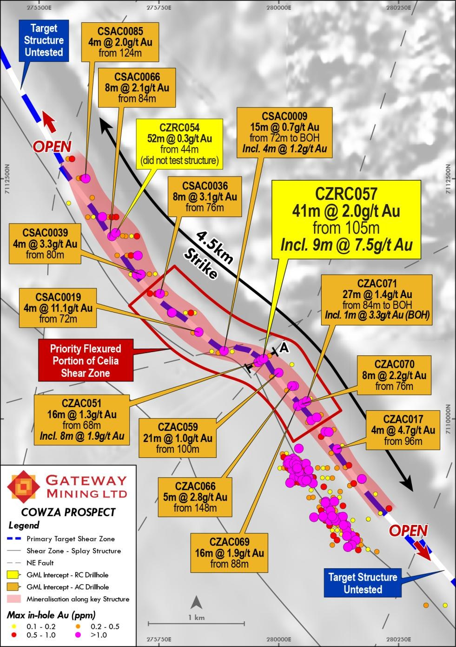
COWZA DISCOVERY
First Hole Into the Primary Structure
41m @ 2.0 g/t Au
Incl. 9m @ 7.5 g/t Au from 105m
CZRC057¹
High-grade gold mapped over 4.5km along the favourable mafic–intermediate contact, hosted within a 4.5km de-mag zone.
Historic drilling focused on “footwall” mineralisation and never tested the main primary structure.
Gateway’s aircore drilling defined a coherent, continuous trend of high-grade gold — the target had never been drill-tested before Gateway’s involvement.
RC drilling has now confirmed the discovery in fresh rock; the structure remains open along strike in both directions.
1. Refer to ASX announcement 2 September 2026.
8

Slide 9
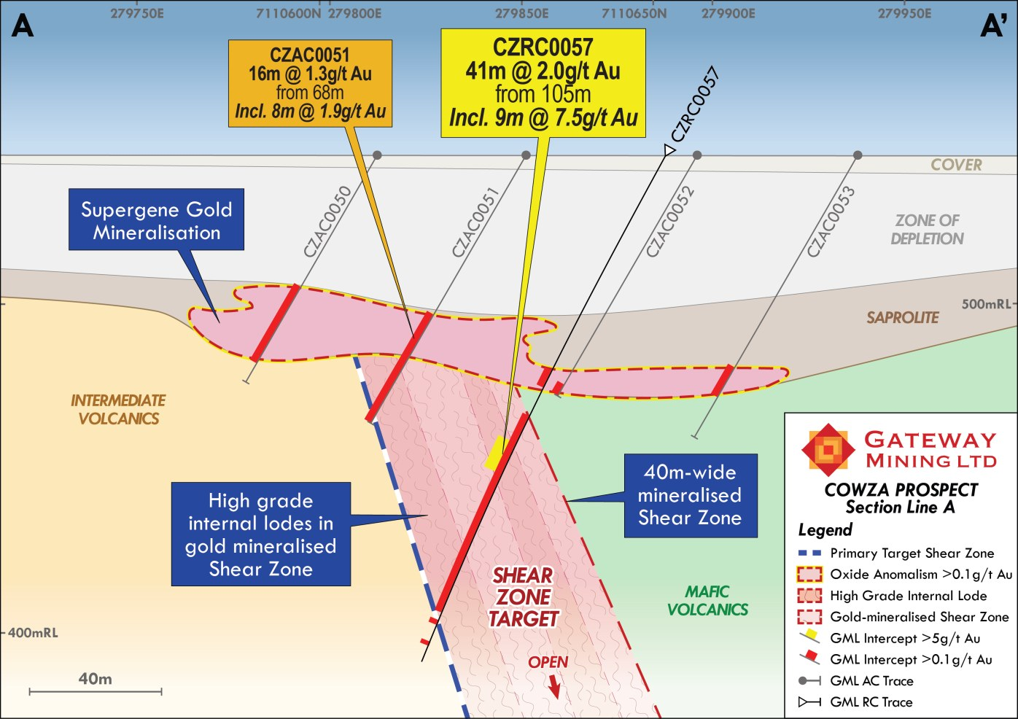
COWZA DISCOVERY
Oxide Grade Becomes Fresh-Rock Grade
Aircore oxide mineralisation directly overlies a 40m-wide gold-mineralised shear zone
8m @ 1.9 g/t Au in oxide
… becomes 41m @ 2.0 g/t Au in fresh rock directly beneath (CZRC057) — a demonstration of what oxide grade turns into at depth.¹
A 40m-wide mineralised shear zone
High-grade internal lodes within a broad, gold-mineralised shear zone on the primary target structure.
CZRC054 (~2km north): 52m @ 0.3 g/t Au¹
Did not intersect the target structure — that position remains untested and open.
Next steps
RC drilling is ongoing; diamond rigs arrive later this month to test the fresh-rock lodes at depth.
1. Refer to ASX announcement 2 September 2026.
9

Slide 10
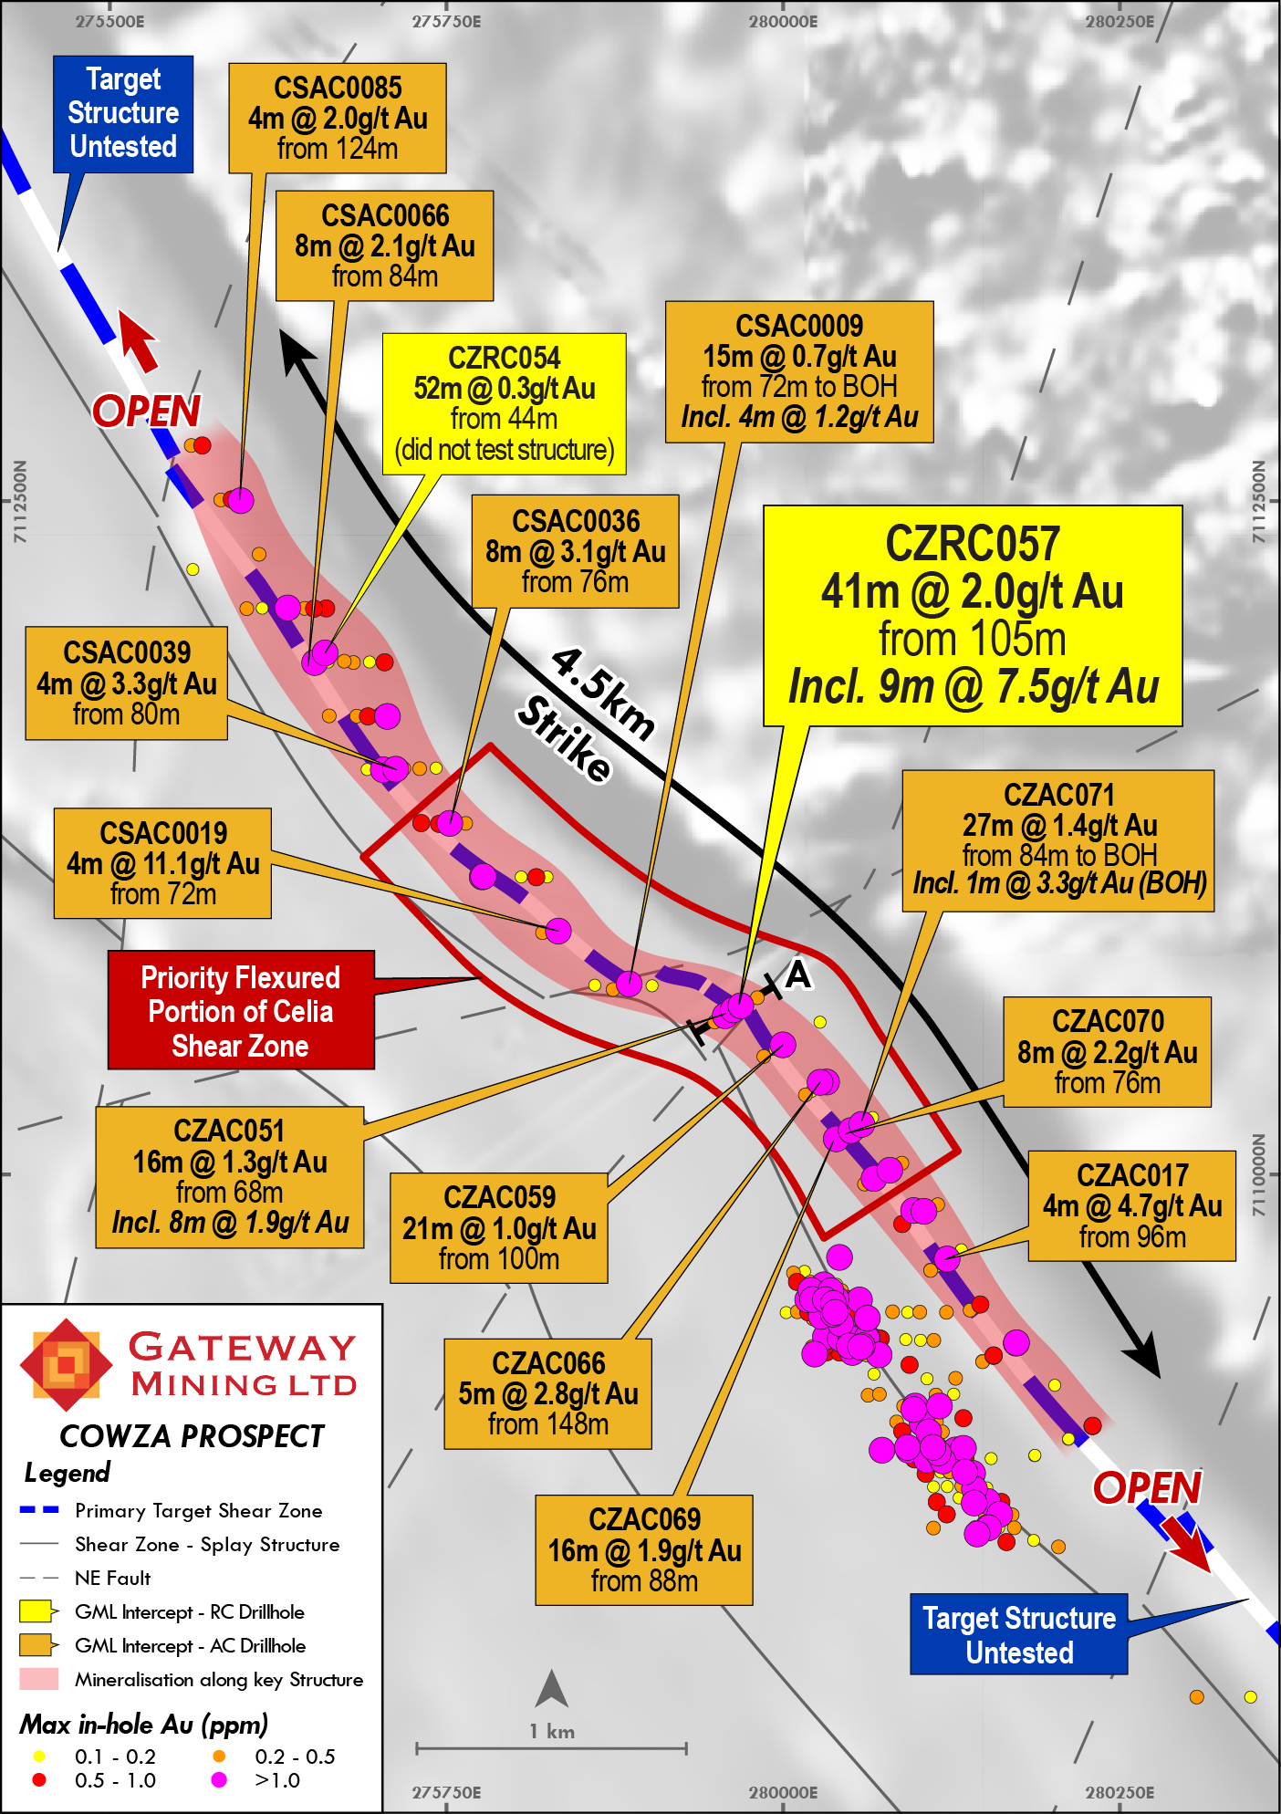
COWZA DISCOVERY
Thick, High-Grade Intercepts
A priority focus at the centre of the Cowza system where:
  the sheared mafic-intermediate contact flexures.
  It is further cut by multiple cross-cutting northeast-trending faults – where the high-degree of dilation would be likely to result in increased gold accumulation.
Aircore drill results across this zone returned multiple thick gold intercepts spanning 1.6km of strike associated with increased veining, degree of shearing and sulphides:¹
  CSAC0019: 4m @ 11.1g/t Au
  CZAC051: 16m @ 1.3g/t Au, including 8m @ 1.9g/t Au
  CZAC071: 27m @ 1.4g/t Au to BOH
  CZAC059: 21m @ 1.0g/t Au.
1.Refer to ASX announcements dated 21 July 2026 and 27 July 2026.

Slide 11
CELIA SHEAR ZONE
Emerging Gold System
Cowza, Celia South and Ward prospects comprise of more than 13km of mineralised strike, hosted within a favourable sequence of mafic and intermediate volcanic rocks.
Extensive oxide mineralisation is proven to be underpinned by high grade primary gold mineralisation.
Large portions of the Cowza, Celia South and Ward trends are yet to be tested by deeper drilling - potential to define additional high-grade gold mineralisation along strike and at depth.

Slide 12
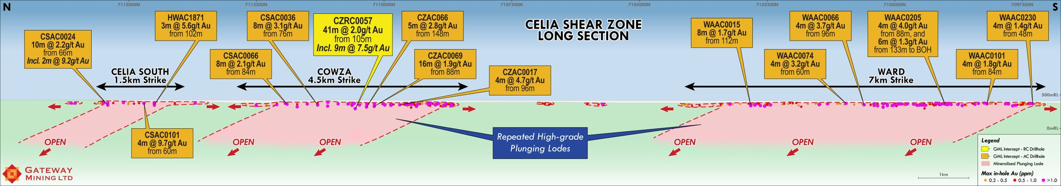
CELIA SHEAR ZONE
13 Kilometres of Mineralised Strike on One Structure
Repeated high-grade plunging lodes from Celia South through Cowza to Ward — large portions untested by deeper drilling
Celia South · 1.5km
Cowza · 4.5km
Ward · 7km
N
S
CELIA SOUTH¹
COWZA²
WARD³
CSAC0024 10m @ 2.2 g/t Au incl. 2m @ 9.2 g/t
CSAC0101 4m @ 9.7 g/t Au
HWAC1871 3m @ 5.6 g/t Au (historic)
CZRC057 41m @ 2.0 g/t Au incl. 9m @ 7.5 g/t (RC)
CSAC0036 8m @ 3.1 g/t Au
CZAC017 4m @ 4.7 g/t Au
WAAC0205 4m @ 4.0 g/t Au and 6m @ 1.3 g/t to end of hole
WAAC0066 4m @ 3.7 g/t Au
WAAC0074 4m @ 3.2 g/t Au
Refer to ASX announcement dated 3 June 2026, 22 June 2026 and 26 August 2026.
Refer to ASX Announcements dated 22 June 2026, 27 July 2026, 2 September 2026.
Refer to ASX announcement 26 August 2026.
11

Slide 13
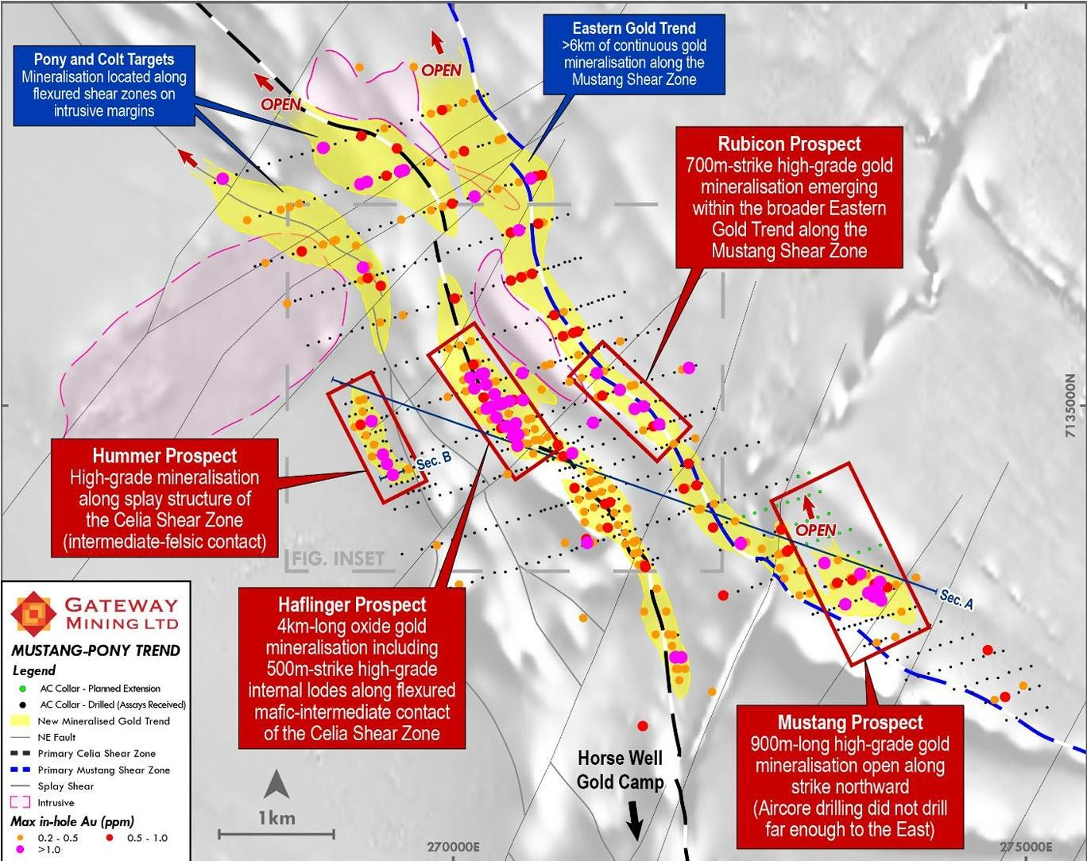
HAFLINGER REGION
A Second High-Grade Camp Taking Shape
Multiple new targets generated from the major aircore program — Haflinger (priority), Hummer, Rubicon and Mustang
OUTSTANDING RESULTS TO DATE¹
64m @ 1.2 g/t Au
MPAC0291 from 56m, incl. 24m @ 2.4 g/t Au
52m @ 1.4 g/t Au
MPAC0262 from 64m, incl. 12m @ 3.1 g/t Au
20m @ 1.4 g/t Au
MPAC0264 from 64m, incl. 4m @ 6.0 g/t Au
Haflinger: 4km-long oxide gold system including 500m of high-grade internal lodes on the flexured mafic–intermediate contact of the Celia Shear Zone.
Eastern Gold Trend: >6km of continuous gold mineralisation along the Mustang Shear Zone, with Rubicon emerging as a 700m-strike high-grade zone.
Mustang: 900m of high-grade gold, open along strike to the north — aircore did not drill far enough east.
1. Refer to ASX announcement dated 22 January 2026 and 23 February 2026.
13

Slide 14
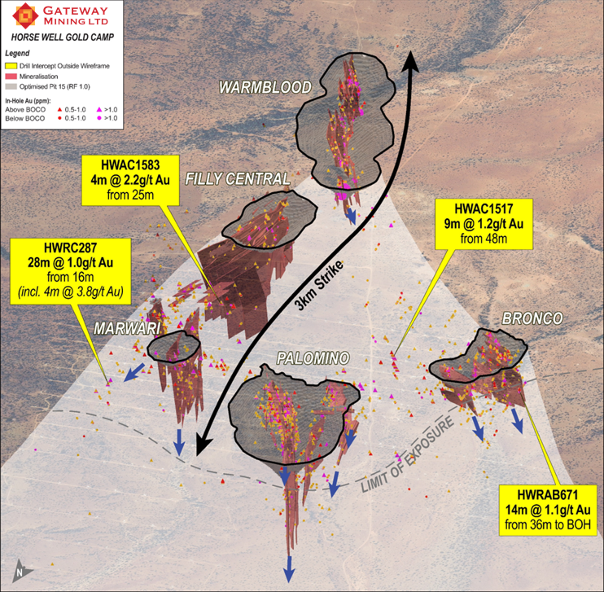
HORSE WELL GOLD CAMP
The 400koz Resource Foundation
Inferred Mineral Resources across Palomino, Warmblood, Filly, Bronco and Dusk 'til Dawn — all from surface, open down-dip and down-plunge
Mineral resource estimates have been completed across Palomino, Warmblood, Bronco and Filly Central.
All resources are from surface and remain open down dip and plunge.
Large portions of modelled mineralisation remains ‘unclassified’ and is excluded from MREs.
Oxide + transition inferred mineral resource of 103k ozs @ 1.8 g/t Au.¹
Combined open pit mineralisation of 278k ozs @ 1.9g/t Au (at AUD4k pit optimisation).²
1. 1.9Mt @ 1.8 g/t Au for 108k oz Au Inferred.
2. 4.52Mt @ 1.9 g/t Au for 278k oz Au Inferred.
Refer to “Appendix A: Yandal Inferred Mineral Resource Estimates” for further details regarding the Yandal Mineral Resource.
Prospect | Tonnes (t) | Au (g/t) | Au (oz) | Cut-off
Palomino Pit | 1,963,000 | 1.84 | 116,000 | 0.5
Palomino UG | 155,000 | 2.69 | 13,500 | 2.0
Palomino Total | 2,118,000 | 1.90 | 129,500 | -
Warmblood | 1,656,000 | 2.37 | 126,000 | 0.5
Filly | 581,000 | 1.15 | 21,500 | 0.5
Bronco | 324,000 | 1.38 | 14,500 | 0.5
HWGC Subtotal | 4,679,000 | 1.94 | 291,500 | -
Dusk 'til Dawn | 3,495,600 | 1.00 | 108,900 | 0.5
Yandal Project Total | 8,174,600 | 1.52 | 400,400

Slide 15
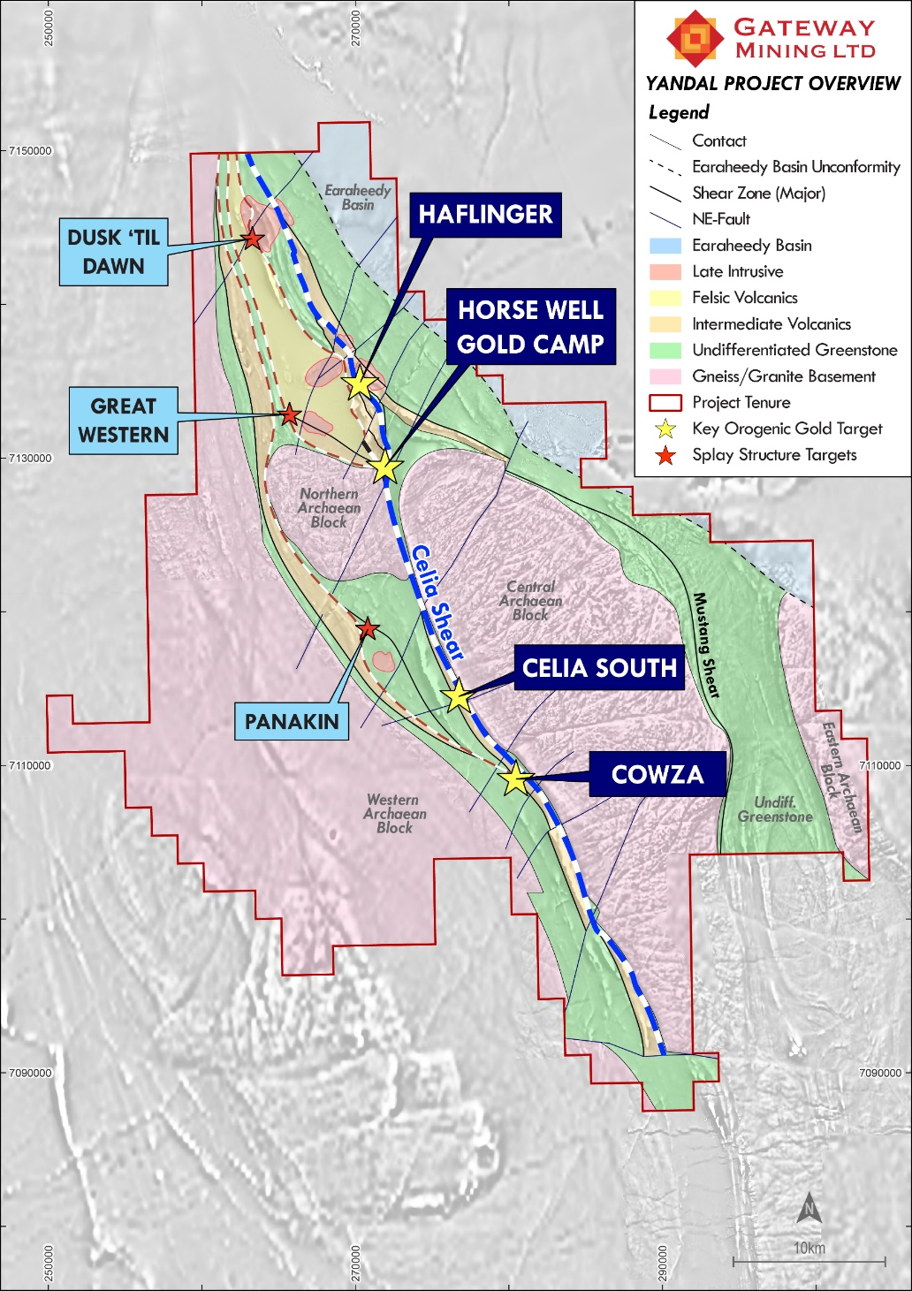
AU–AG SPLAY STRUCTURE TARGETS
Project Overview
70km of prospective greenstone belt.
Orogenic Gold Targets
  Significant gold mineralisation based on four key factors:
    Mafic-intermediate contact - creates the perfect rheological contrast for significant gold mineralisation to be deposited.
    Northeast trending structures – creating zones of dilation required for hydrothermal gold bearing fluids to infiltrate.
    Zones of de-magnetization – evidence of magnetic destruction of host rocks as part of the hydrothermal gold system.
    Deep seated basinal structure – Celia Shear Corridor.
Gold-Silver ‘Splay Structure’ Targets
  Positioned along regional ‘splay structures’ and associated ‘late intrusions’.
    Great Western
    Great Western South
    Dusk ‘til Dawn
GWS

Slide 16
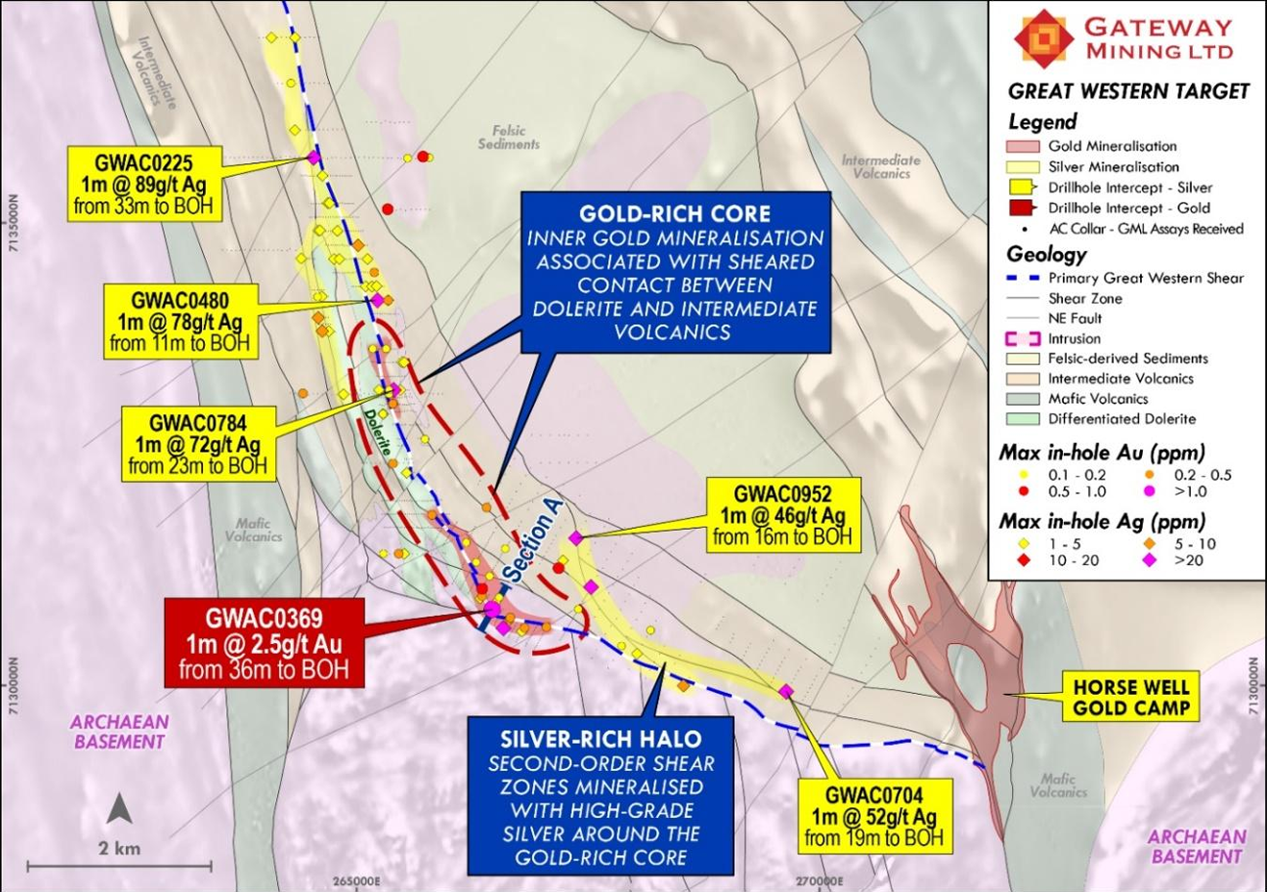
AU–AG SPLAY STRUCTURE TARGETS
Great Western — A Large Gold–Silver System, Barely Skimmed
Golden Mile-style zonation: gold in the hot, ductile core; silver in the cooler, brittle halo
Large scale gold-silver system defined by drilling.¹
Extensive BOH gold anomalism in intensely sheared dolerite.
Unexpectedly, high grade BOH silver intersected along the shear corridor
Evidence of a very substantial. hydrothermal – drilling has only ‘skimmed’ across the top.
Highly analogous to the Golden Mile – gold concentrated in ductile intensely sheared dolerite margin (hotter part); silver in the outward more brittle deformation zones (cooler part).
Exploration work ongoing – RC drilling later this year.
1. Refer to ASX announcements dated 23 June 2026.

Slide 17
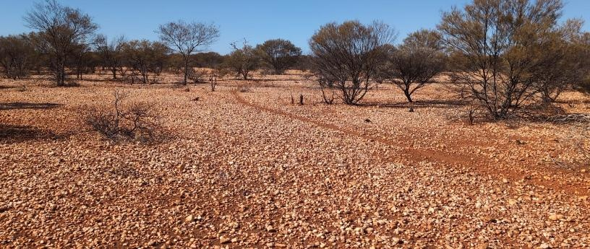
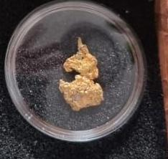
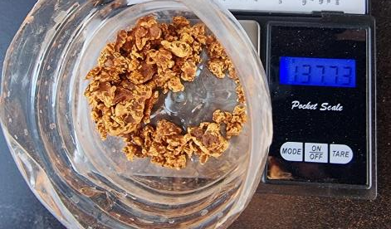
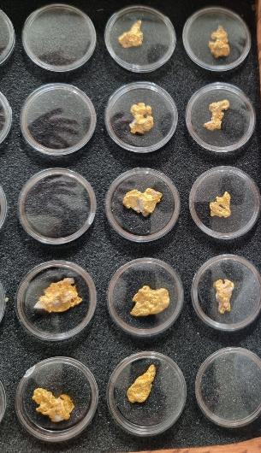
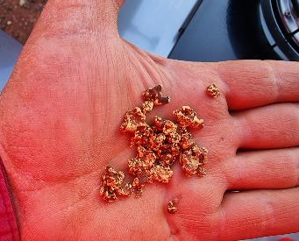
AU–AG SPLAY STRUCTURE TARGETS
Great Western — Nuggets Galore!!
Golden Mile-style zonation: gold in the hot, ductile core; silver in the cooler, brittle halo
Cautionary Statement:
Visual estimates of mineral abundance should never be considered a proxy or substitute for laboratory analyses where concentrations or grades are the factor of principal economic interest. Visual estimates also potentially provide no information regarding impurities or deleterious physical properties relevant to valuations.
The gold mineralisation reported is in nuggety form. The minerals visually observed is native free gold, however, being nuggets, they have not been assayed to confirm purity and if any other trace elements may be present. The Company notes gold nuggets showing this colour typically have a high gold purity.
The abundance of gold is constrained to the 134 nuggets reported. The nuggets range in size from 1.5 grams to approximately 26.5 grams and have an angular habit. The nuggets were discovered near surface on tenement E69/2765 to a maximum depth of approximately 40cm using metal detecting equipment. The nuggets are not representative of the entire area with approximately 60% of the nuggets confined to an area approximately 200m (north-south) x 100m (east-west) – centered around 265,380mE and 7,133,110mN (Grid MGA94 Zone 51). The remainder of the nuggets were dispersed along the recently defined surface sampling gold anomaly for approximately 1.2 kilometres of strike on tenement E69/2765.
The Company will undertake additional exploration activities to further assess the abundance of gold within the area where the nuggets were discovered, and across the wider Yandal Project. As previously announced, a wider soil sampling program is ongoing, to map this new anomalous gold trend to Horse Well. A trial 2D IP survey line will also be undertaken across the peak gold anomaly defined to date across Great Western. This survey will be completed once the 3D IP survey across Dusk ‘til Dawn has been finalised. Both set of results will be released to the market in due course. Drilling plans will be released to the market after the Company receives and reports these results.
Refer to ASX Announcement dated 17 September 2025 for full details regarding nugget samples.
17
Notes:
17

Slide 18
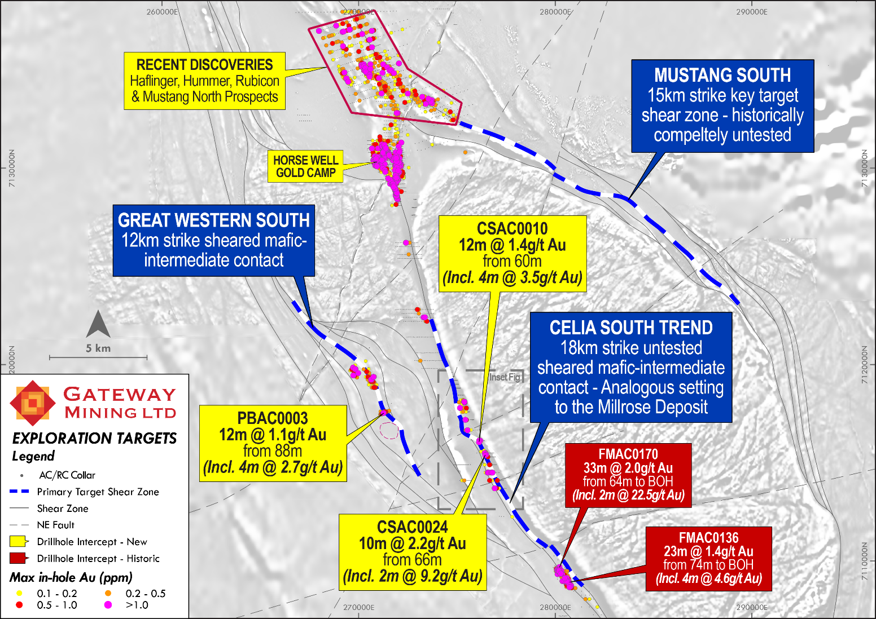
AU–AG SPLAY STRUCTURE TARGETS
Great Western South
The southern extension of the shear corridor that hosts Great Western
Southern extension of the shear corridor that hosts Great Western.¹
12km strike of sheared mafic-intermediate contact (the key contact).
First pass drilling intersected¹ :
  PBAC0003: 12m @ 1.1g/t Au incl 3m @ 2.7g/t Au.
1. Refer to ASX announcement dated 3 June 2026.

Slide 19
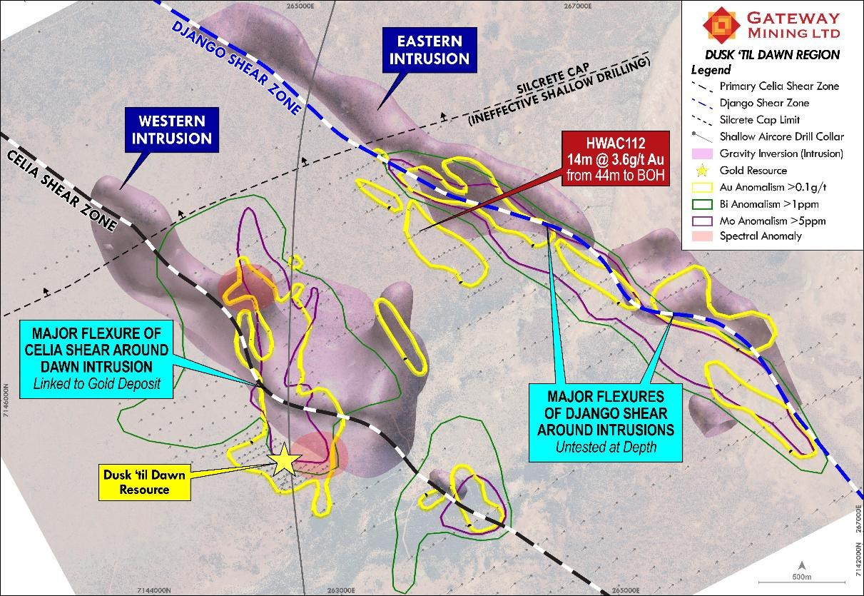
AU–AG SPLAY STRUCTURE TARGETS
Dusk 'til Dawn — A 109koz Resource With Intrusion-Related Upside
Extensive geophysics has defined key intrusions either side of the Celia Shear Zone — a very large hydrothermal system
Extensive geophysical work has defined the key Western and Eastern intrusions.
Alteration and large Au–Ag–Mo–Cu–Bi–Te geochemical trends coincide with the intrusive features.
Major flexures of the Celia and Django shear zones around the intrusions — linked to the existing gold deposit and untested at depth.
Resource: 3.5Mt @ 1.0 g/t Au for 108,900oz Inferred (0.5 g/t cut-off).
PEAK RESULTS¹
33m @ 3.6 g/t Au
14m @ 10.0 g/t Au
from 61m — DTDR001
from 50m — DDRC001
13m @ 8.8 g/t Au
30m @ 2.0 g/t Au
from 111m — DDRC014
from 144m — ACDR003
1. Refer to ASX announcement 2 July 2025.
17

Slide 20
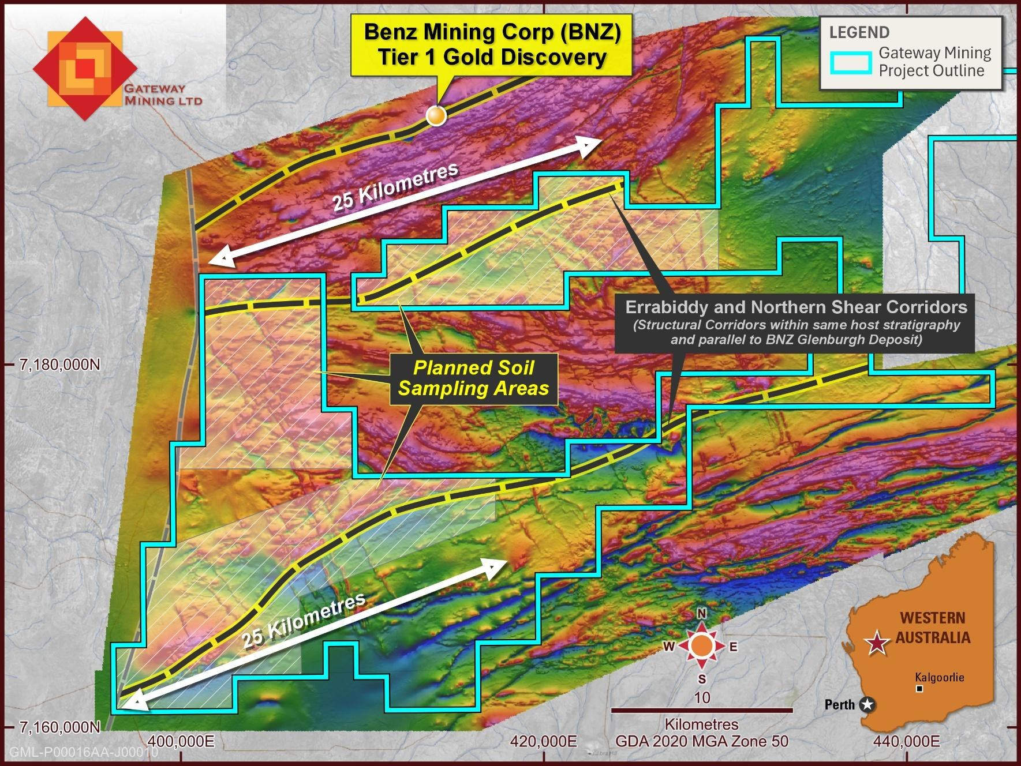
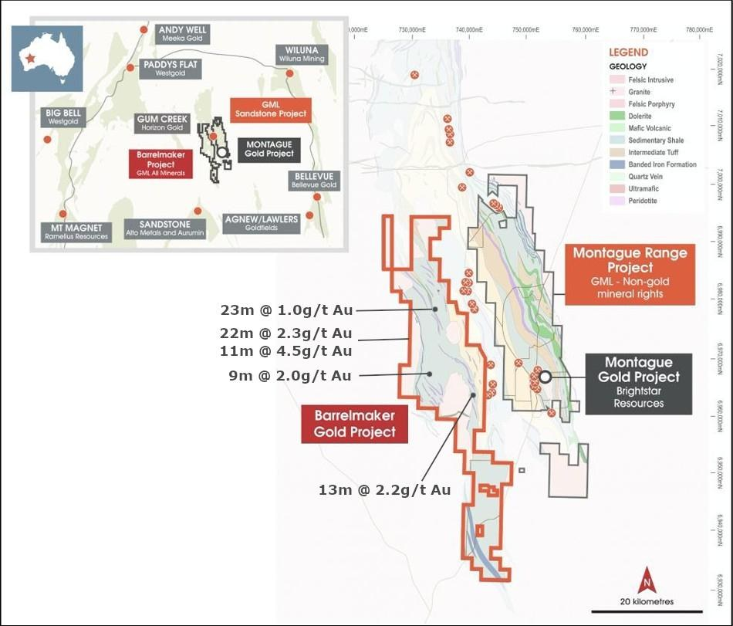
PORTFOLIO
Beyond Yandal — Two More Gold Projects in WA
Early-stage optionality across two additional Western Australian gold belts
Glenburgh South
Barrelmaker
Strategic acquisition in a highly prospective location¹
80km of prospective strike in the Gum Creek Greenstone Belt
Adjacent to Benz Mining Corp's Tier 1 Glenburgh gold discovery, with early signs of similar mineralisation
Repeat fault structures south of Glenburgh — the Errabiddy and Northern shear corridors (~25km each) sit within the same host stratigraphy, parallel to the Glenburgh deposit
Airborne magnetic survey completed²; surface sampling currently underway
Historic intercepts include 22m @ 2.3 g/t Au, 11m @ 4.5 g/t Au, 23m @ 1.0 g/t Au and 13m @ 2.2 g/t Au³
Geological model built across the project area with a strong focus on drill-target testing
First-pass drilling programs scheduled for later this year
Refer to ASX announcement dated 15 September 2026 for full transaction details.
Refer to ASX announcement dated 9 March 2026.
Refer to ASX announcement dated 9 December 2024.
18

Slide 21
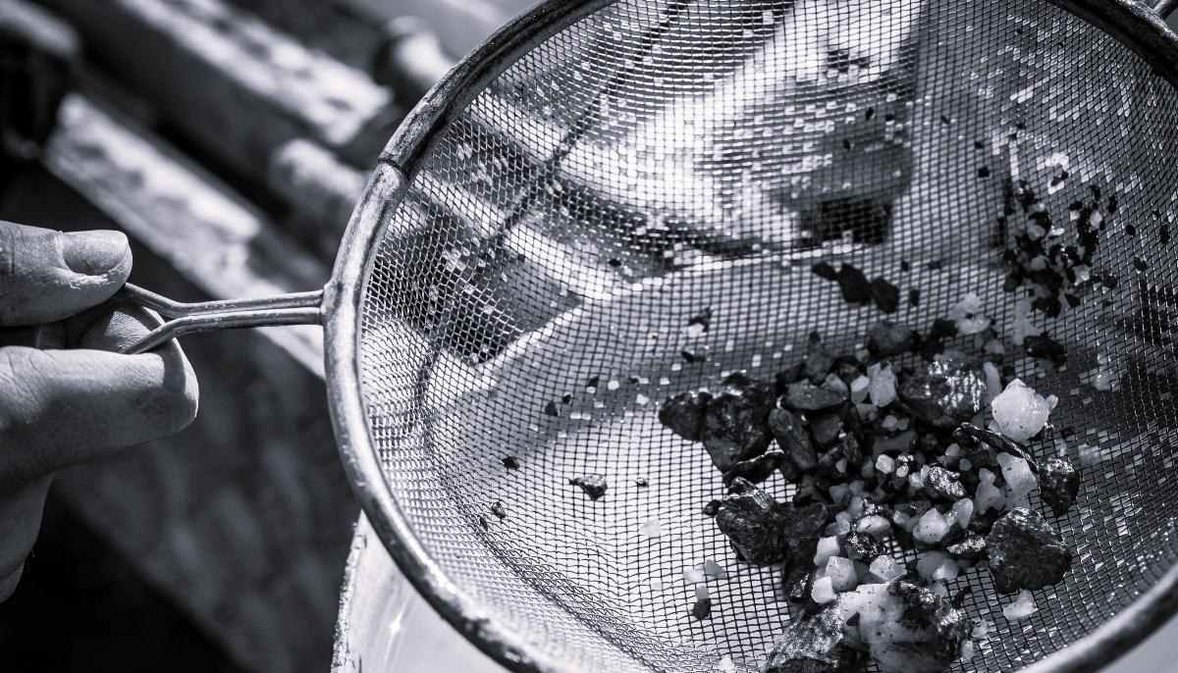
INVESTMENT CASE
Why Gateway, Why Now
1
A district-scale position in the Yandal belt — 70km of prospective greenstone, 50km from Northern Star's Yandal Operations Centre.
2
Cowza: a high-grade fresh-rock discovery on a primary structure that historic drilling never tested — 41m @ 2.0 g/t Au incl. 9m @ 7.5 g/t Au.
3
13km of mineralised strike, seven drill-defined targets and an existing 400koz Inferred resource base, open at depth.
4
A four-factor targeting model validated by discovery — now being applied across the belt with RC and diamond rigs.
5
An aligned, experienced team, A$15.1M in cash and liquids (30 June 2026) plus $45M Placement completed in September and a steady flow of drill results ahead.
Yandal — Australia's next multi-million-ounce gold camp
23

Slide 22
APPENDIX A
Yandal Inferred Mineral Resource Estimates
Prospect | Tonnes (t) | Au (g/t) | Au (oz) | Cut-off (g/t Au)
Palomino Pit | 1,963,000 | 1.84 | 116,000 | 0.5
Palomino UG | 155,000 | 2.69 | 13,500 | 2.0
Palomino Total | 2,118,000 | 1.90 | 129,500 | -
Warmblood | 1,656,000 | 2.37 | 126,000 | 0.5
Filly | 581,000 | 1.15 | 21,500 | 0.5
Bronco | 324,000 | 1.38 | 14,500 | 0.5
HWGC Subtotal | 4,679,000 | 1.94 | 291,500 | -
Dusk 'til Dawn | 3,495,600 | 1.00 | 108,900 | 0.5
Yandal Project Total | 8,174,600 | 1.52 | 400,400
TABLE NOTES
Mineral Resources are based on JORC Code definitions as defined by the Australasian Code for Reporting of Exploration Results, Mineral Resources and Ore Reserves.
All figures are rounded to reflect appropriate levels of confidence. Apparent differences may occur due to rounding.
The Mineral Resource Estimate has been estimated using appropriate high-grade cuts, minimum mining widths and dilutions.
Tonnes rounded to the nearest 1,000t, ounces rounded to the nearest 500oz.
Refer to ASX announcement dated 2 July 2025 titled “Acquisition of Yandal Gold Project from Strickland Metals Ltd” for further details regarding the MRE.
24

Slide 23
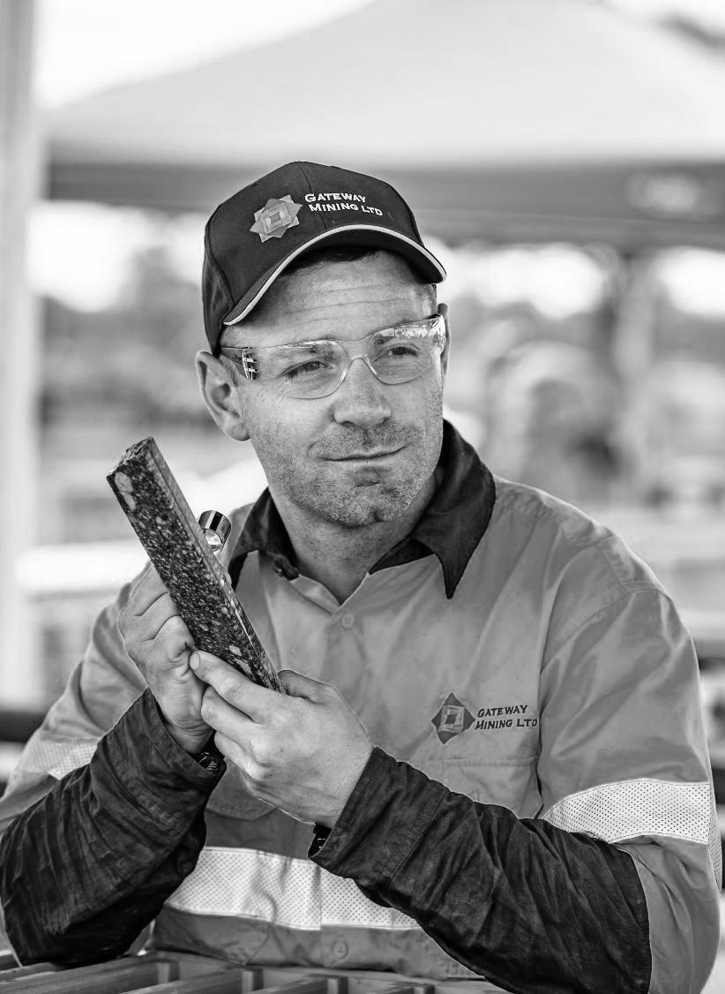






Thank You
Contact Details
Level 4, 15 Ogilvie Road, Mount Pleasant WA 6153, Australia
info@gatewaymining.com.au
+61 8 6317 9875 www.gatewaymining.com.au
Notes:
23

