Slide 1


SUN SILVER LIMITED
Maverick Silver Project, Nevada, USA
Resources Rising Stars – Gold Coast 2026
ASX: SS1 (OTCQX:SSLVF)
September 2026

Slide 2

IMPORTANT INFORMATION
Not a disclosure document
The purpose of this presentation is to provide general information about the Company and the Maverick Silver Project (Project) only. This presentation is not a disclosure document for the purpose of Chapter 6D of the Corporations Act 2001 (Cth) (Corporations Act) and does not purport to include the information required of such a disclosure document. It has not been approved by any regulatory authority such as the Australian Securities and Investments Commission or the Australian Securities Exchange.
This Presentation also does not constitute or form part of any invitation, offer for sale or subscription or any solicitation for any offer to buy or subscribe for any Securities nor shall they or any part of them form the basis of or be relied upon in connection therewith or act as any inducement to enter into any contract or commitment with respect to Securities.
Forward-looking statements
This Presentation may contain certain forward-looking statements, guidance, forecasts, estimates or projections in relation to future matters (Forward Statements) that involve risks and uncertainties, and which are provided as a general guide only. Forward Statements can generally be identified by the use of forward looking words such as “anticipate”, “estimate”, “will”, “should”, “could”, “may”, “expects”, “plans”, “forecast”, “target” or similar expressions and include, but are not limited to, indications of, or guidance or outlook on, future earnings or financial position or performance of the Company. The Company can give no assurance that these expectations will prove to be correct. You are cautioned not to place undue reliance on any forward-looking statements. None of the Company, its directors, employees, agents or advisers represent or warrant that such Forward Statements will be achieved or prove to be correct or gives any warranty, express or implied, as to the accuracy, completeness, likelihood of achievement or reasonableness of any Forward Statement contained in this presentation. Actual results may differ materially from those anticipated in these forward-looking statements due to many important factors, risks and uncertainties. The Company does not undertake any obligation to release publicly any revisions to any “forward- looking statement” to reflect events or circumstances after the date of this Presentation, except as may be required under applicable laws.
Not an Offer
This Presentation is for information purposes only. The Presentation does not comprise a prospectus, product disclosure statement or other offering document under Australian law (and will not be lodged with ASIC) or any other law. This Presentation also does not constitute or form part of any invitation, offer for sale or subscription or any solicitation for any offer to buy or subscribe for any Securities nor shall they or any part of them form the basis of or be relied upon in connection therewith or act as any inducement to enter into any contract or commitment with respect to Securities.
Disclaimer
The Company does not make any representation or warranty as to the accuracy or completeness of the information in the Presentation and shall not have any liability for any information or representations (express or implied) contained in, or for any omissions from, the Presentation. To the maximum extent permitted by law, none of the Company, its directors, employees or agents, advisers, nor any other person accepts any liability whether direct or indirect, express or limited, contractual, tortuous, statutory or otherwise, in respect of, the accuracy or completeness of the information or for any of the opinions contained in this Presentation or for any errors, omissions or misstatements or for any loss, howsoever arising, from the use of this Presentation.
Competent Person Statement
The information in this Presentation that relates to previously reported exploration results and estimates of mineral resources at the Maverick Silver Project is extracted from the Company’s ASX announcements dated 22 August 2024, 24 September 2024, 3 December 2024, 14 January 2025, 26 March 2025, 2 July 2025, 16 July 2025, 31 July 2025, 12 August 2025, 25 August 2025, 3 September 2025, 15 October 2025, 20 November 2025, 9 December 2025, 5 March 2026, 23 July 2026, 3 August 2026, 19 August 2026, 3 September 2026 and 8 September 2026 (Original Announcements). The Company confirms that it is not aware of any new information or data that materially affects the relevant information contained in Original Announcements and, in the case of estimates of mineral resources, that all material assumptions and technical parameters underpinning the mineral resource estimate continue to apply and have not materially changed.
Metal Equivalents
References to metal equivalents (AgEq) are based on an equivalency ratio of 85, which is derived from a gold price of USD$2,433 and a silver price of USD$28.50 per ounce, being derived from the average monthly metal pricing for the last three years, and average metallurgical recovery. This is calculated as follows: AgEq = Silver grade + (Gold Grade x ((Gold Price * Gold Recovery) / (Silver Price * Silver Recovery))) i.e. AgEq (g/t) = Ag (g/t) + (Au (g/t) x ((2433 x 0.85) / (28.50 x 0.85))). Metallurgical recoveries of 85% have been assumed for both silver and gold. Preliminary metallurgical recoveries were disclosed in the Company’s prospectus dated 17 April 2024, which included a review of metallurgical test work completed by the prior owners of Maverick Silver. Metallurgical recoveries for both gold and silver were recorded in similar ranges, with maximum metallurgical recoveries of up to 97.5% in preliminary historical metallurgical testing in respect of silver and up to 95.8% in respect of gold. Gold recoveries were commonly recorded in the range of 80% - 90%, and the midpoint of this range has been adopted at present in respect of both silver and gold. It is the Company’s view that both elements referenced in the silver and gold equivalent calculations have a reasonable potential of being recovered and sold.
2

Slide 3
LARGEST PRE-PRODUCTION PRIMARY SILVER PROJECT WITHIN THE US
JORC INFERRED MINERAL RESOURCES ESTIMATE
539 Moz
Silver Equivalent at 71 g/t
347.2 Moz
2.25 Moz
Silver at 45.5 g/t
Gold at 0.30g/t
Refer to Appendix A and the Company's ASX announcement dated 9 December 2025 for further details regarding the Maverick Silver Project mineral resource estimate.
“Largest” refers to ounces of silver contained in a mineral resource estimate reported in accordance with JORC or another recognised industry code. ‘Primary Silver Project’ is defined as silver being the primary commodity contained within the resource and makes up the majority percentage of the silver equivalent resource.
3

Slide 4
OUTSTANDING TRANSFORMATION IN JUST OVER 2 YEARS
 | May 2024 (IPO) |  | September 2026
Market Capitalisation | A$25M |  | A$213M
Share Price | A$0.20 |  | A$1.15
Mineral Resource | 292,000,000 oz AgEq |  | 539,000,000 oz AgEq
Daily Trading Volume* | A$650k / 1m Shares |  | A$2.21m / 1.83m Shares
Silver Price | USD $29 per oz |  | USD $65.68 per oz
*Average daily trading volume for May 2024 represents the average of the first six months of trading following the Company’s IPO on 15 May 2024. The September 2026 figure reflects the average daily trading volume calculated from 3 August 2026 to 31 August 2026.
752%
475%
85%
240%
126%
4

Slide 5








CORPORATE SUMMARY
CAPTIAL STRUCTURE | ASX: SS1
Existing Shares on Issue | 185.5m
Market Capitalisation (price 7/09 $1.15) | A$213m
Cash (As at 30-Jun-26) | A$23m
Enterprise Value (EV) | A$190m
BOARD, MANAGEMENT AND ADVISORS
 | Andrew Dornan Managing Director Andrew is a seasoned mining executive with 20+ years in exploration and project development. As co-founder of Sun Silver, he identified silver’s growing supply deficit and led the Maverick Silver acquisition. Previously held senior roles at Newmont, Rio Tinto, Fortescue and Pilbara Minerals advancing projects from exploration to operations. |  | Shaun Hardcastle Non-Executive Chair Shaun has a distinguished legal career spanning 20 years, with experience across corporate, commercial and securities law as well as non-executive director roles across various ASX-listed companies. Shaun is currently a Partner and the Head of Corporate for the national law firm Hamilton Locke.
 | Dean Ercegovic Non-Executive Director Founding Director and Chief Operating Officer of Primero Group. Primero operates in multiple regions globally (including North America) and is an industry leader in the design, construction and operations of mineral processing facilities. |  | Nathan Marr Non-Executive Director Nathan is a qualified metallurgist who has over 20 years’ experience in the mining industry. Nathan has project managed and delivered over 10 operating plants in various commodities.
 | Dennis Lindgren Strategic Advisor Former Alcoa Director of Strategy and Business Development, specialising in U.S. critical minerals. Identified and established the Wagerup Gallium Project, which recently secured US$600 million in U.S. Government funding. Brings 19 years' experience in commercial project development, permitting and strategic resource project execution. |  | Jay Ward Group Manager - Geology Experienced Exploration Manager, Jay played a key role in Strickland Metals Limited (ASX: STK), managing the company's Yandal gold assets in Western Australia, including the expansion of the Millrose Gold Deposit leading to its sale to Northern Star Resources Ltd (ASX: NST).
MAJOR SHAREHOLDERS
Board, Management and Advisors | ~24%
RESEARCH COVERAGE
5

Slide 6
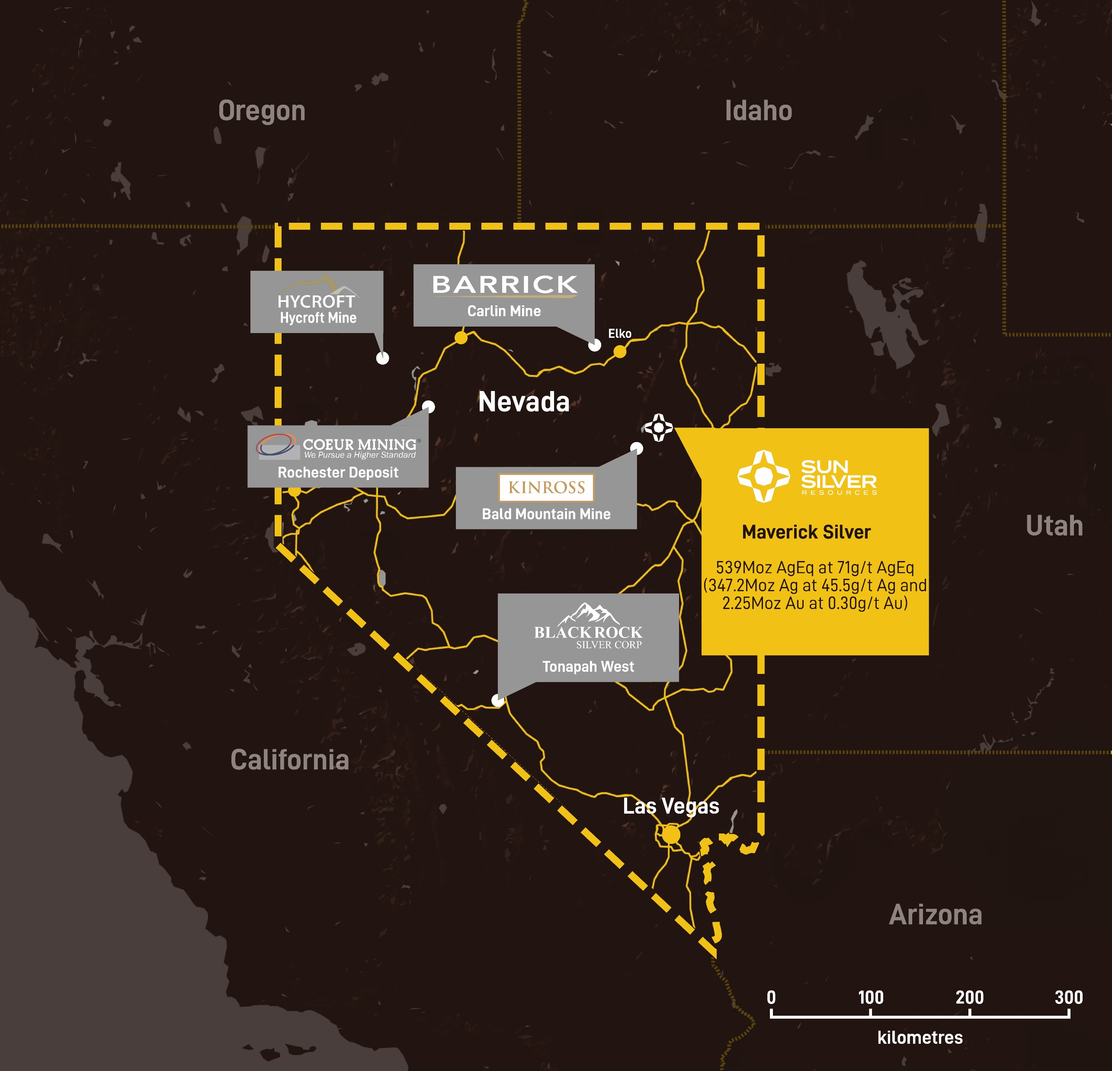
MAVERICK SILVER PROJECT – STRATEGIC FOR U.S. SILVER INDEPENDENCE
Location, Resource Size, Multi-Commodity Potential, Supply Chain Risk and Policy Recognition
Location: Maverick Silver is strategically situated in Nevada, Tier 1 mining jurisdiction that aligns with U.S. critical minerals strategy.
Largest Pre-production primary silver Resource within the U.S.: The project boasts a JORC-compliant mineral resource of 539 Moz silver equivalent, making it the largest pre-production primary silver deposit in the United States.
Multi-Commodity Potential: In addition to silver, Maverick Silver has significant gold mineralisation and antimony, which is vital for the U.S. defence sectors.
Refinement opportunities - Silver Powder and Paste: Silver powder and paste are critical for electronics, batteries, AI data centres, defence, aerospace, sensors and advanced manufacturing, making silver an increasingly strategic industrial and national security material.
6

Slide 7
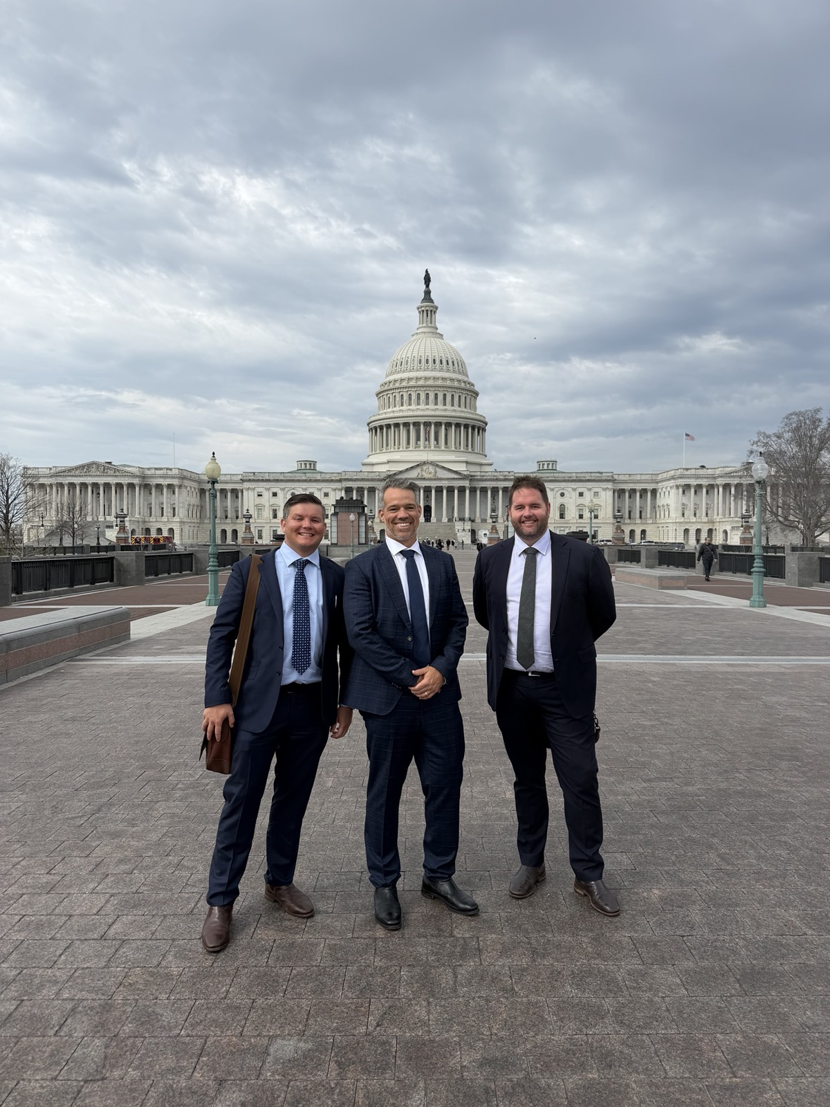
U.S. ENGAGEMENT AND STRATEGIC VULNERABILITY
Domestic Production, Demand vs Supply, Import Dependence, By-product Production Risks
U.S. Government Engagement: Met with senior officials from the Department of Commerce, Department of Energy and EXIM Bank, reinforcing support for domestic critical minerals projects.
Limited Domestic Supply: The U.S. has very few primary silver mines, with most production coming as a by-product of base metal mining, making supply dependent on other commodity markets.
Large Supply Deficit: U.S. Annual silver demand in 2024 was ~240 Moz versus domestic production of only ~35 Moz, creating a ~205 Moz supply gap.
High Import Dependence: More than 80% of U.S. silver supply is imported, exposing strategic supply chain vulnerabilities.
China Policy Shift: Recent export controls and tighter regulation of silver highlight increasing resource nationalism and supply chain risks. (Similar to those previously imposed on Rare Earths.)
United States Government and Department of Commerce have been clear on the US Governments position to support internal critical minerals projects such as Maverick Silver.
7

Slide 8
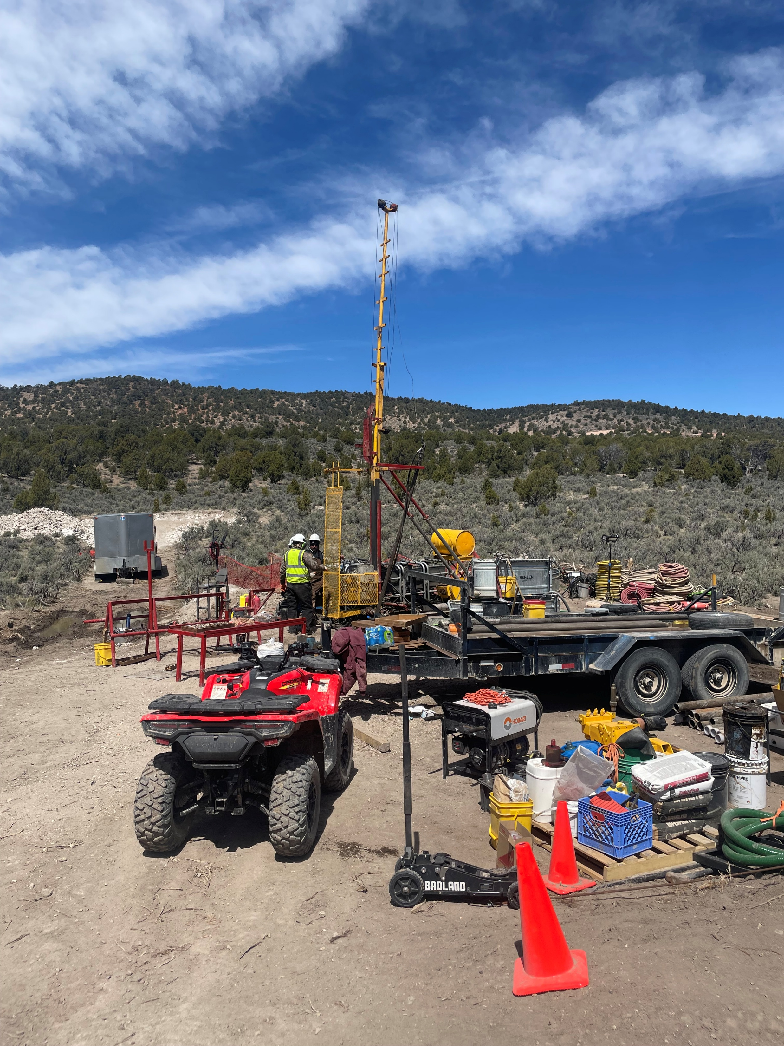
DRILLING REMAINS ONGOING AT MAVERICK SILVER
2026 drill program was designed to advance the Maverick Silver Project across three key priorities:
Priority 1 – Resource Classification Upgrade: targeted infill drilling to improve geological confidence and support conversion of the existing Mineral Resource to the JORC Indicated category;
Priority 2 – Development Advancement: collection of additional metallurgical core to support ongoing development studies and future processing pathways; and
Priority 3 – Resource Growth: step-out drilling targeting the north-west extension of the high-grade hinge-zone mineralisation and other open extensions.
8

Slide 9
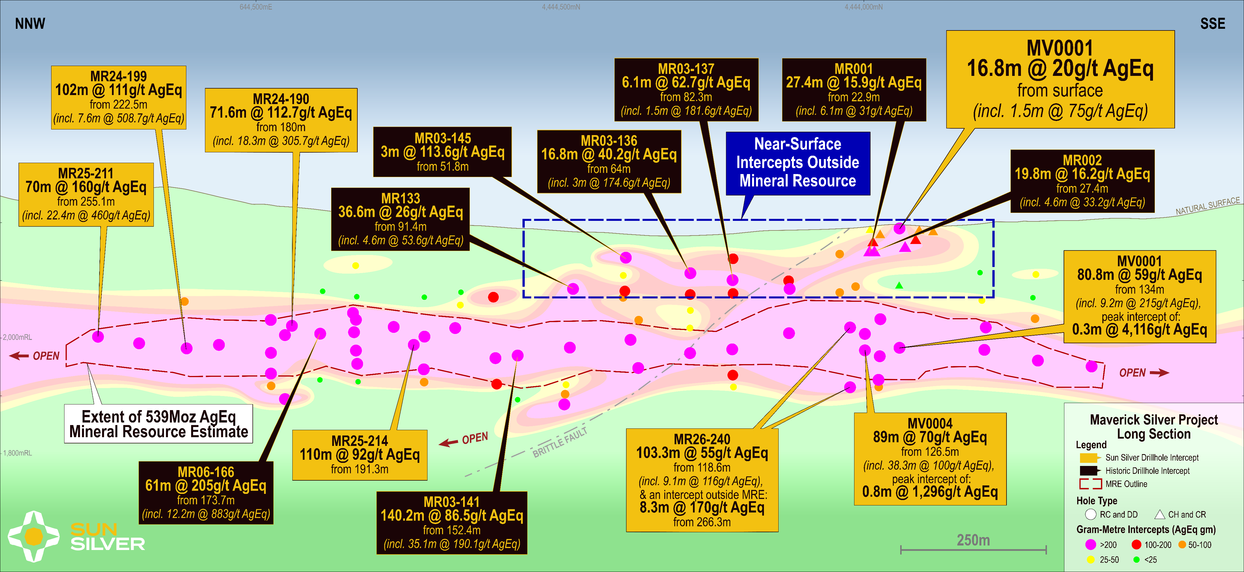
FROM SURFACE MINERALISATION ENHANCES DEVELOPMENT POTENTIAL
First Sun Silver diamond hole to intersect silver-gold mineralisation from surface highlights potential for reduced pre-strip, starter pits and earlier processing feed
From Surface Intercepts
Hole ID | Interval (m) | AgEq (g/t) | Ag (g/t) | Au (g/t) | From (m)
MV0001 | 16.8 | 20 | 11 | 0.1 | 0
including | 3.5 | 46 | 24 | 0.3 | 0
including | 1.5 | 75 | 43 | 0.4 | 1.5
Mineralisation from Surface could provide:
Reduced pre-strip and initial waste movement
Earlier access to mineralised feed
Potential starter pit opportunities
Potential for earlier revenue generation
Greater mine sequencing flexibility
Potential improvement in early mine life capital efficiency
Near-surface grades Compare Favourably with Large Scale Nevada Projects with Coeur Rochester Operates at a grade of 12.63g/t Ag
9
For previously released exploration results refer to the Company’s ASX announcements 24 September 2024, 14 January 2025, 26 March 2025, 2 July 2025, 15 October 2025, 3 August 2026, 3 September 2026 and 8 September 2026.

Slide 10
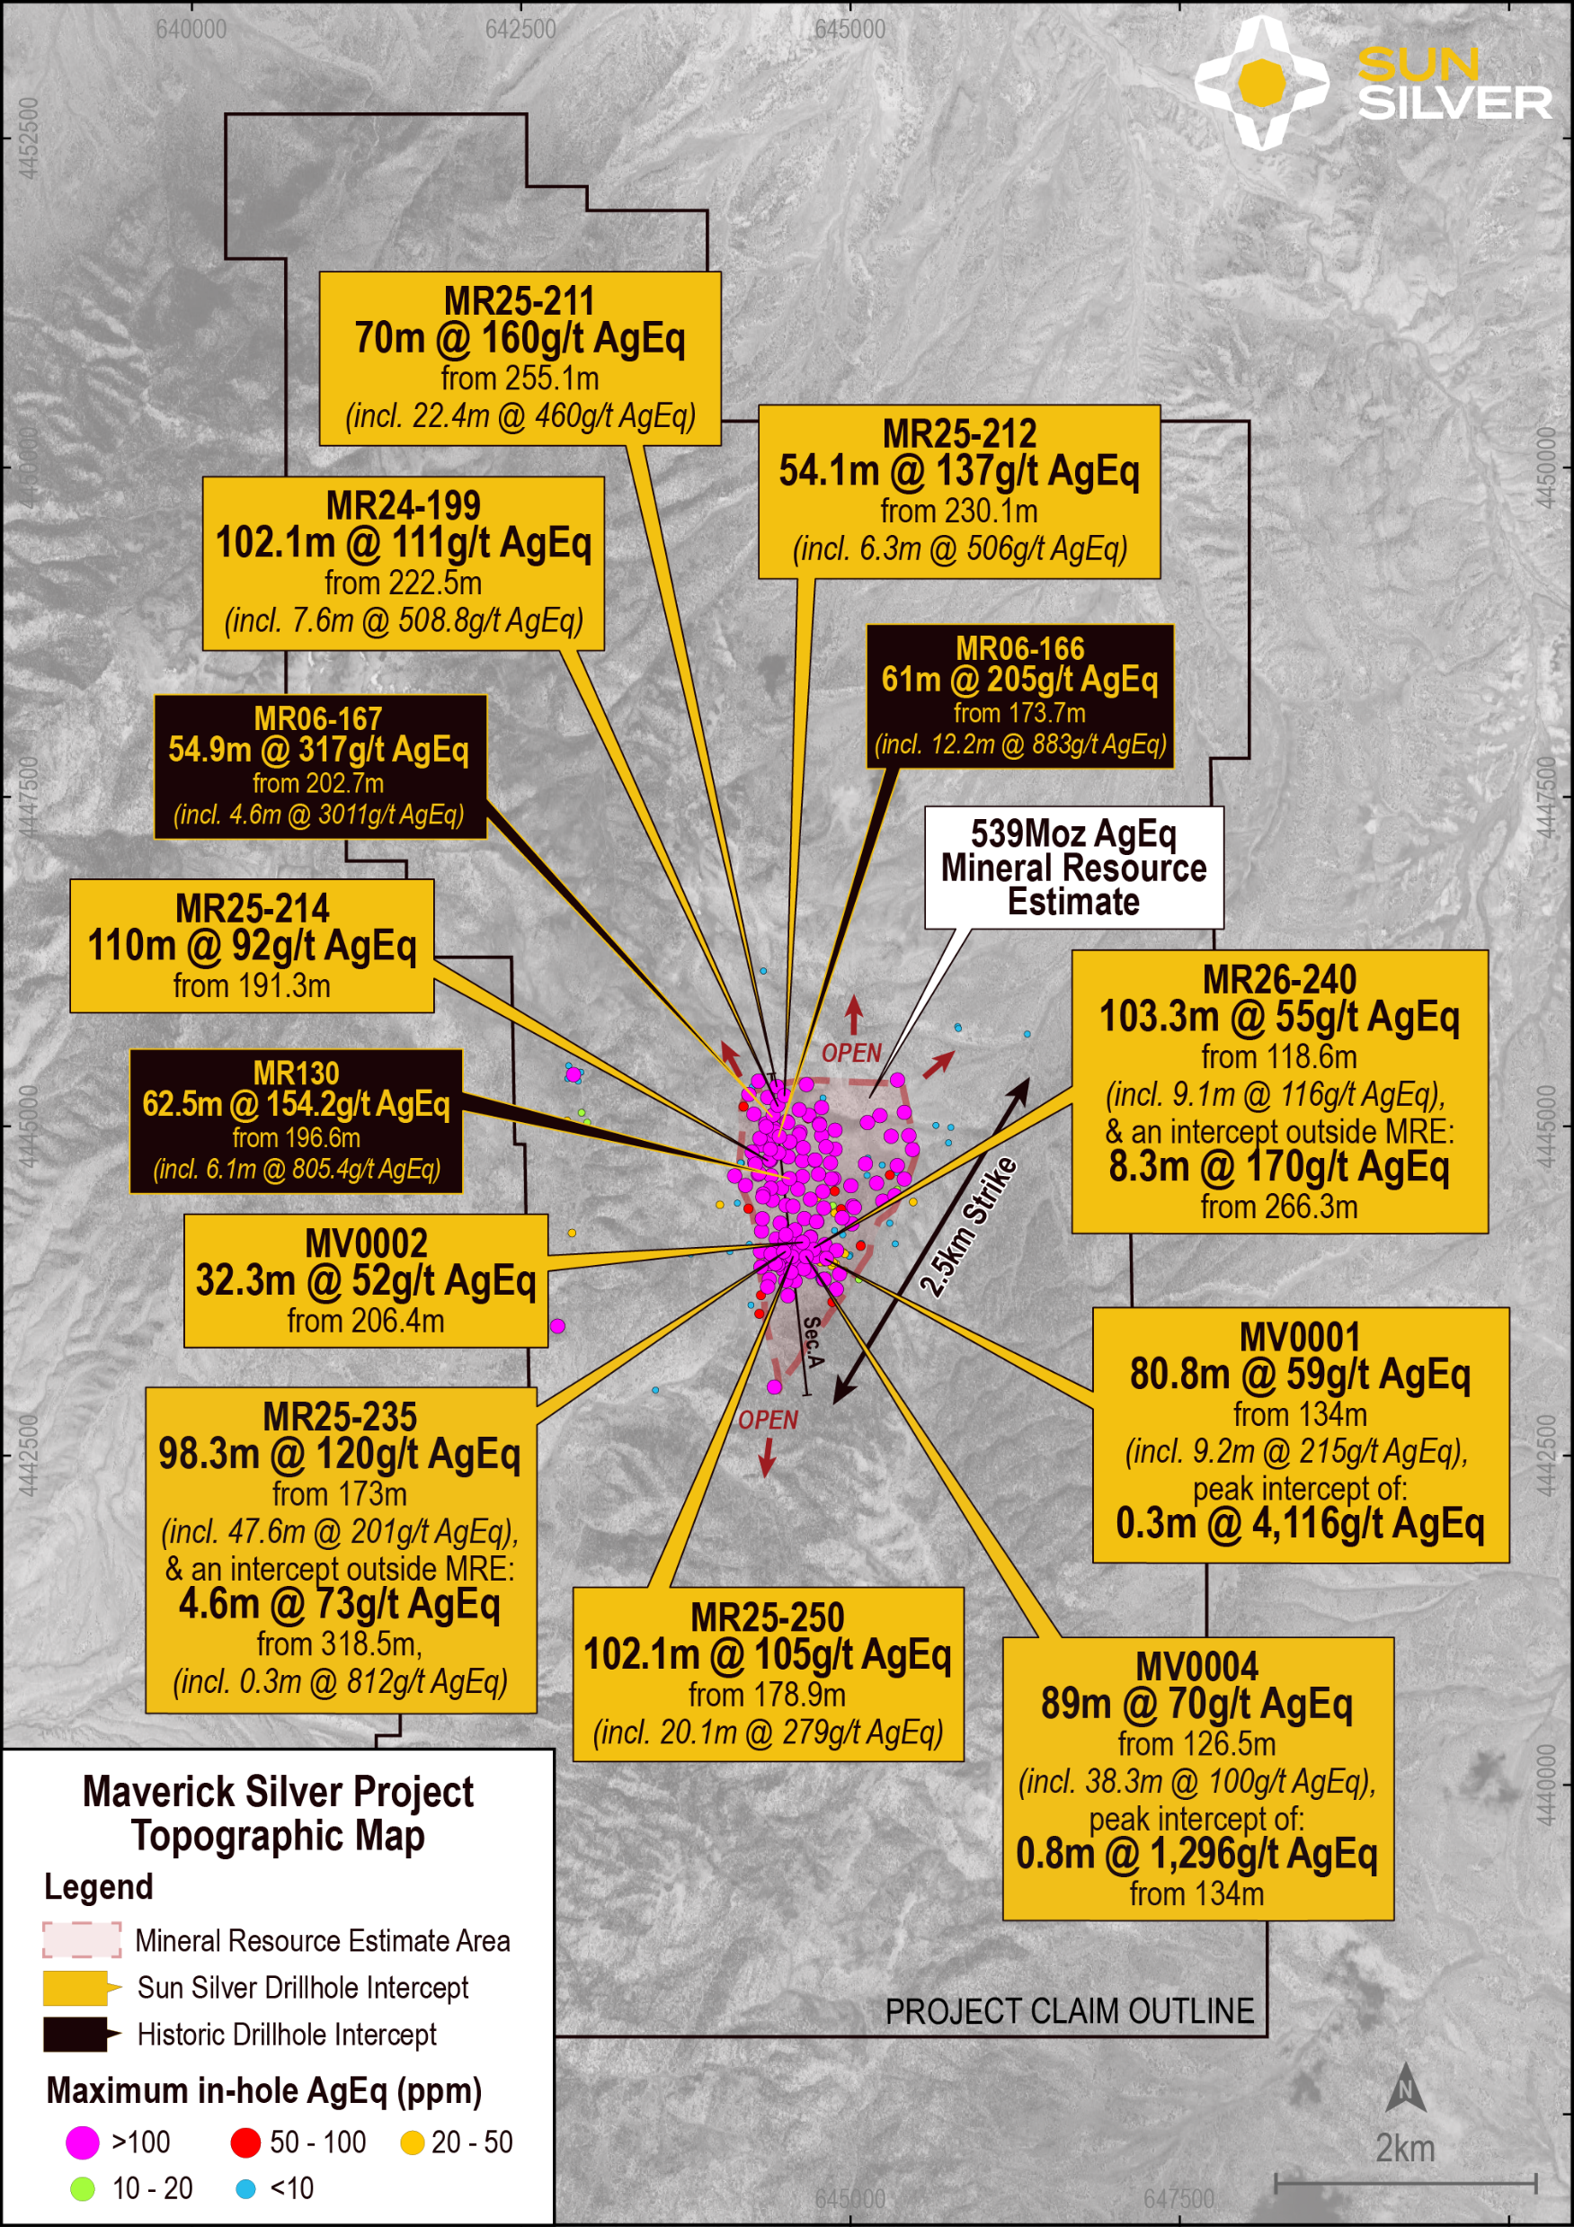
NOTEABLE INTERCEPTS FROM 2026 DRILL PROGRAM
Silver Intercepts:
Hole ID | Interval (m) | AgEq (g/t) | Ag (g/t) | Au (g/t) | From (m)
MR25-235 | 98.3 | 120.3 | 65.7 | 0.67 | 173
including | 47.6 | 200.6 | 119.6 | 1.05 | 176.8
MV0004 | 89 | 70 | 49 | 0.2 | 126.5
including | 38.3 | 100 | 73 | 0.3 | 134
MR25-233 | 114.3 | 52.6 | 17.7 | 0.41 | 178.3
including | 27.9 | 70 | 31 | 0.46 | 178.3
MR26-240 | 103.3 | 55 | 33 | 0.26 | 118.6
Including | 28.2 | 80 | 47 | 0.39 | 205.7
and | 8.3 | 170 | 163.6 | 0.1 | 266.3
Antimony Intercepts:
Hole ID | Interval (m) | Sb (PPM) | From (m)
MR25-233 | 50.3 | 1100 | 178.3
MR26-240 | 16.1 | 1400 | 119.9
MV0004* | 43.7 | 600 | 70.6
including | 19.3 | 1000 | 70.6
and | 64.7 | 600 | 134
Including | 16.5 | 1000 | 164.9
* MV0004 intercepted Antimony 60m above the delineated Silver-Gold MRE.
10
For previously released intercepts not yet referenced refer to the Company’s ASX announcement dated 26 March 2025, 3 September 2025, 20 November 2025, 3 August 2026, 19 August 2026,, 8 September 2026.

Slide 11
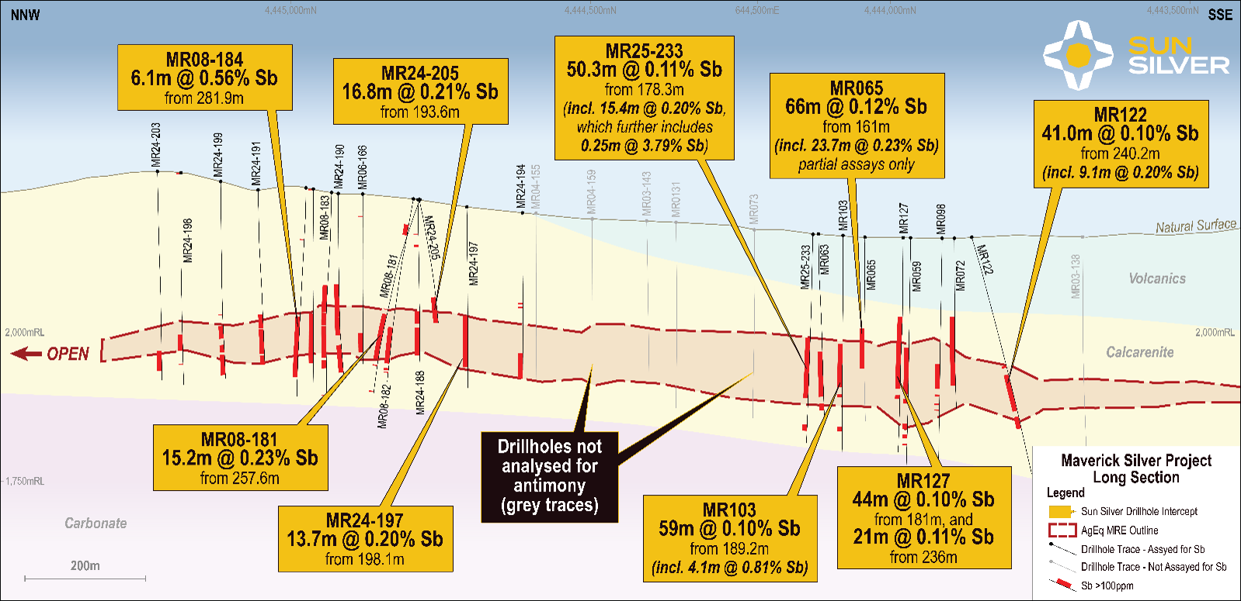
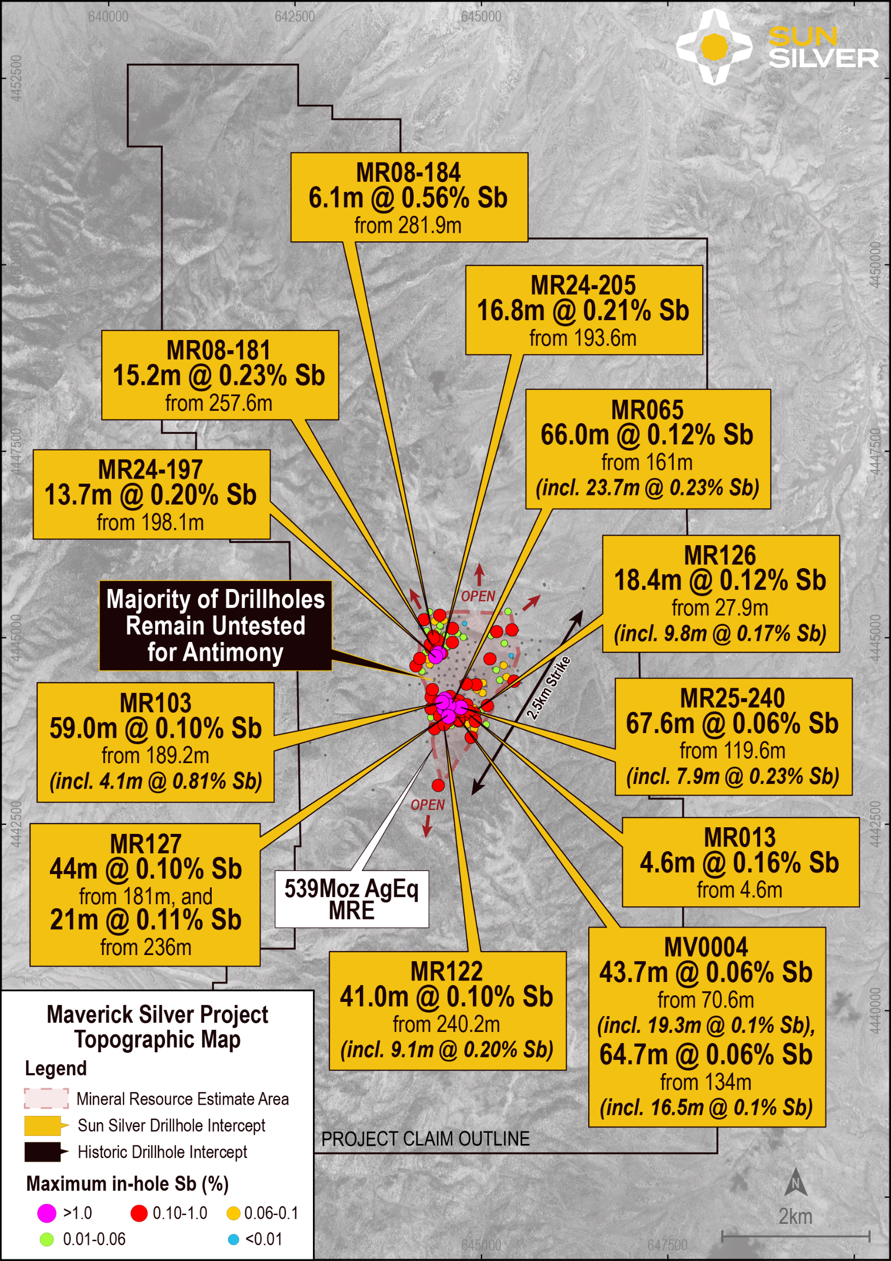
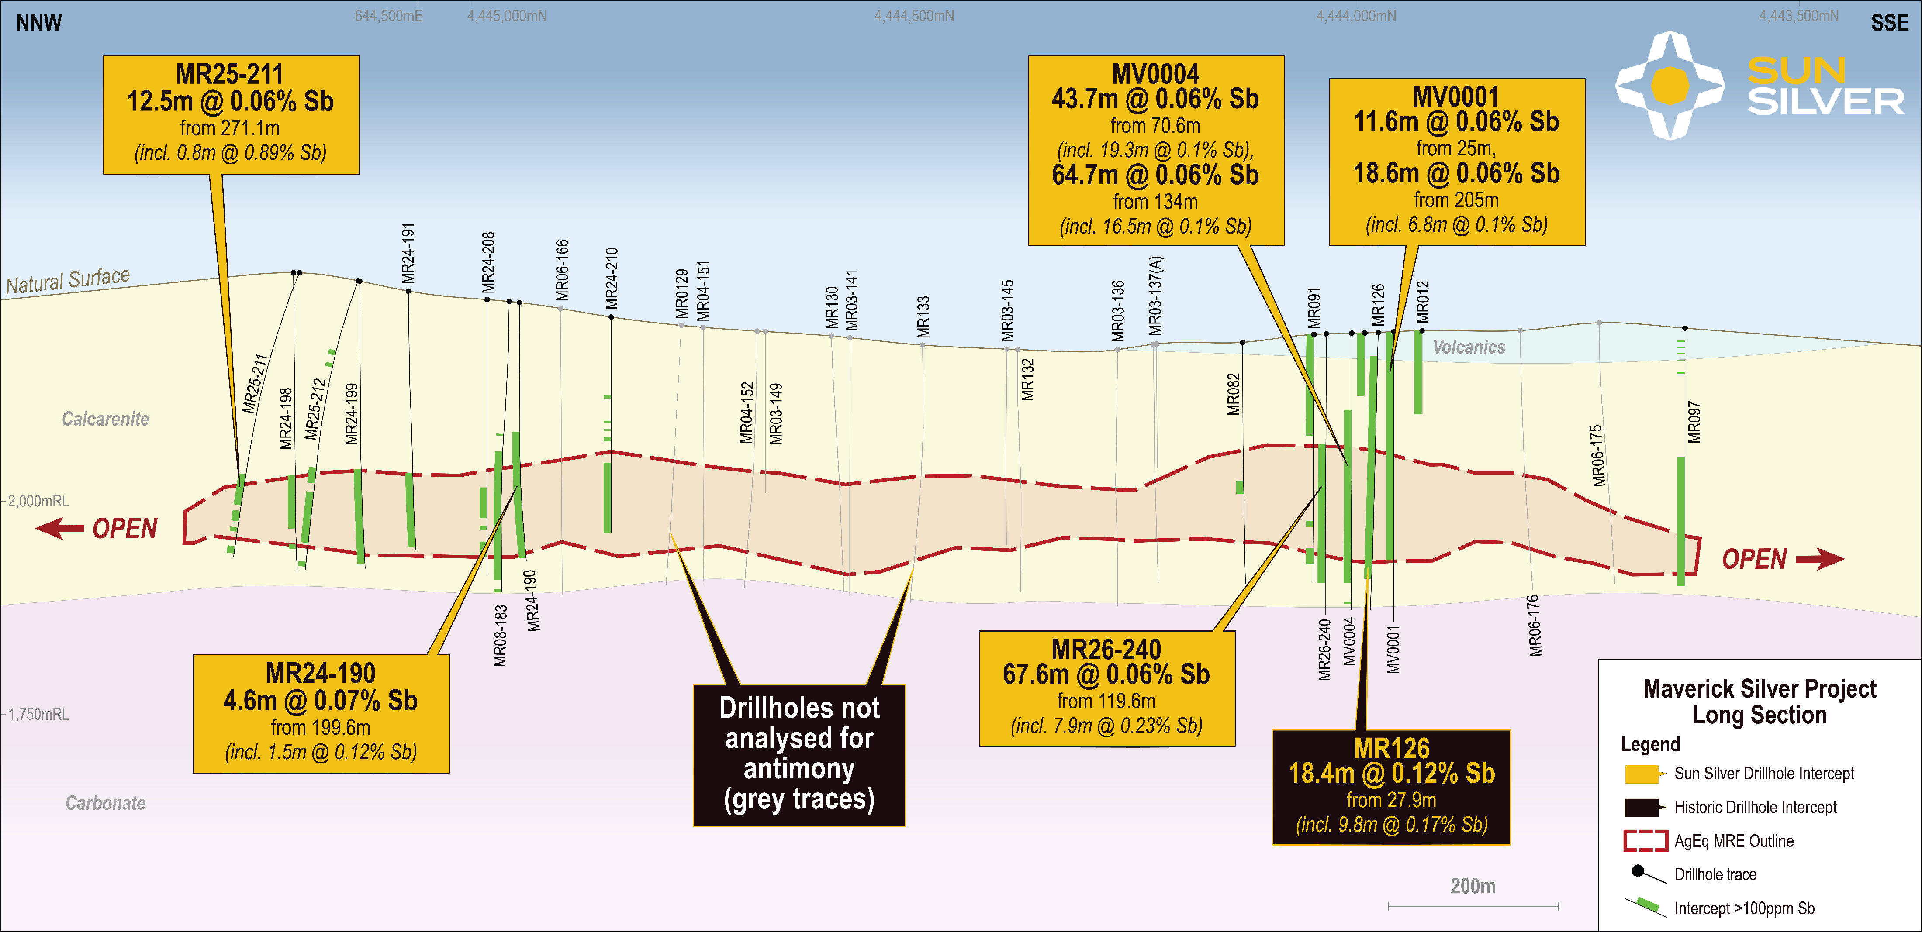
MAVERICK SILVER - ANTIMONY
11
For previously released antimony intercepts refer to the Company’s ASX announcements dated 22 August 2024, 24 September 2024, 3 December 2024, 2 July 2025, 16 July 2025, 31 July 2025, 12 August 2025, 25 August 2025, 20 November 2025, 3 August 2026, 3 September 2026 and 8 September 2026.

Slide 12
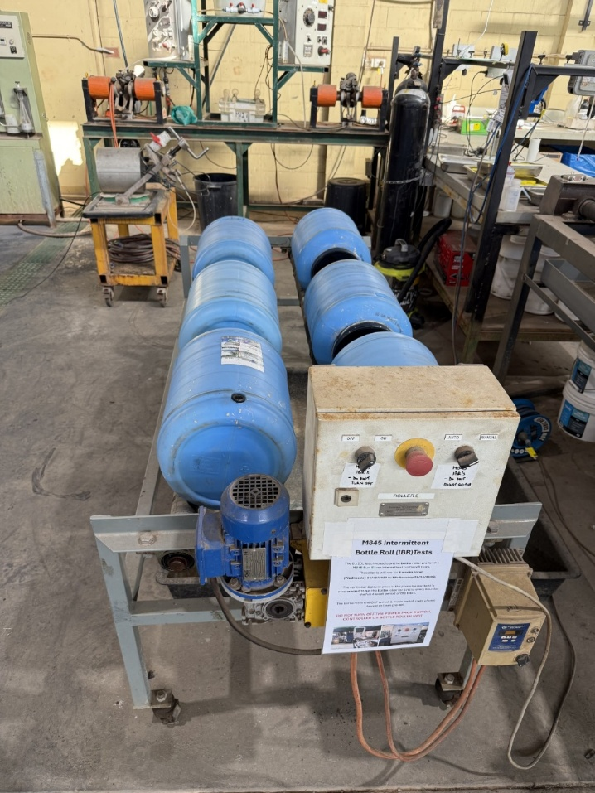
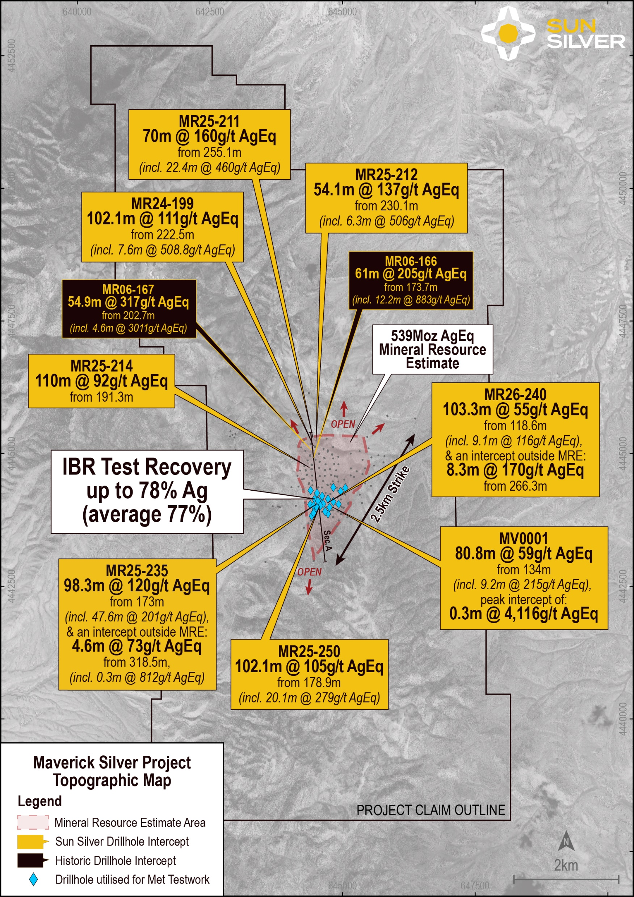
METALLURGICAL RESULTS
Strong Intermittent Bottle Roll (IBR’s) Performance: Silver recoveries up to 78% (avg. 77%) and gold up to 77% (avg. 74%) under early-stage heap leach conditions.
High Recovery Upside: Conventional tank leach results demonstrate silver recoveries up to 90% and gold up to 84.7%.
Favourable Metallurgy: Tested ore was assessed as non-refractory and non-preg robbing in nature with predictable processing behaviour.
Further Upside Identified: Potential recovery improvements via process optimisation including but not limited too water treatment, cyanide dosages, crush size and potentially ore sorting.
Testing Ongoing – IBR’s, Column leach and conventional tank leaching tests ongoing to feed into future studies and trade offs.
IBR Metallurgical Testing two sample composites across three grind sizes (6.3mm, 3.35mm and 2mm)
Maverick Silver Project detailing metallurgical samples drill hole locations
12
For previously reported metallurgical test results refer to the Company’s ASX announcement dated 5 March 2026.

Slide 13
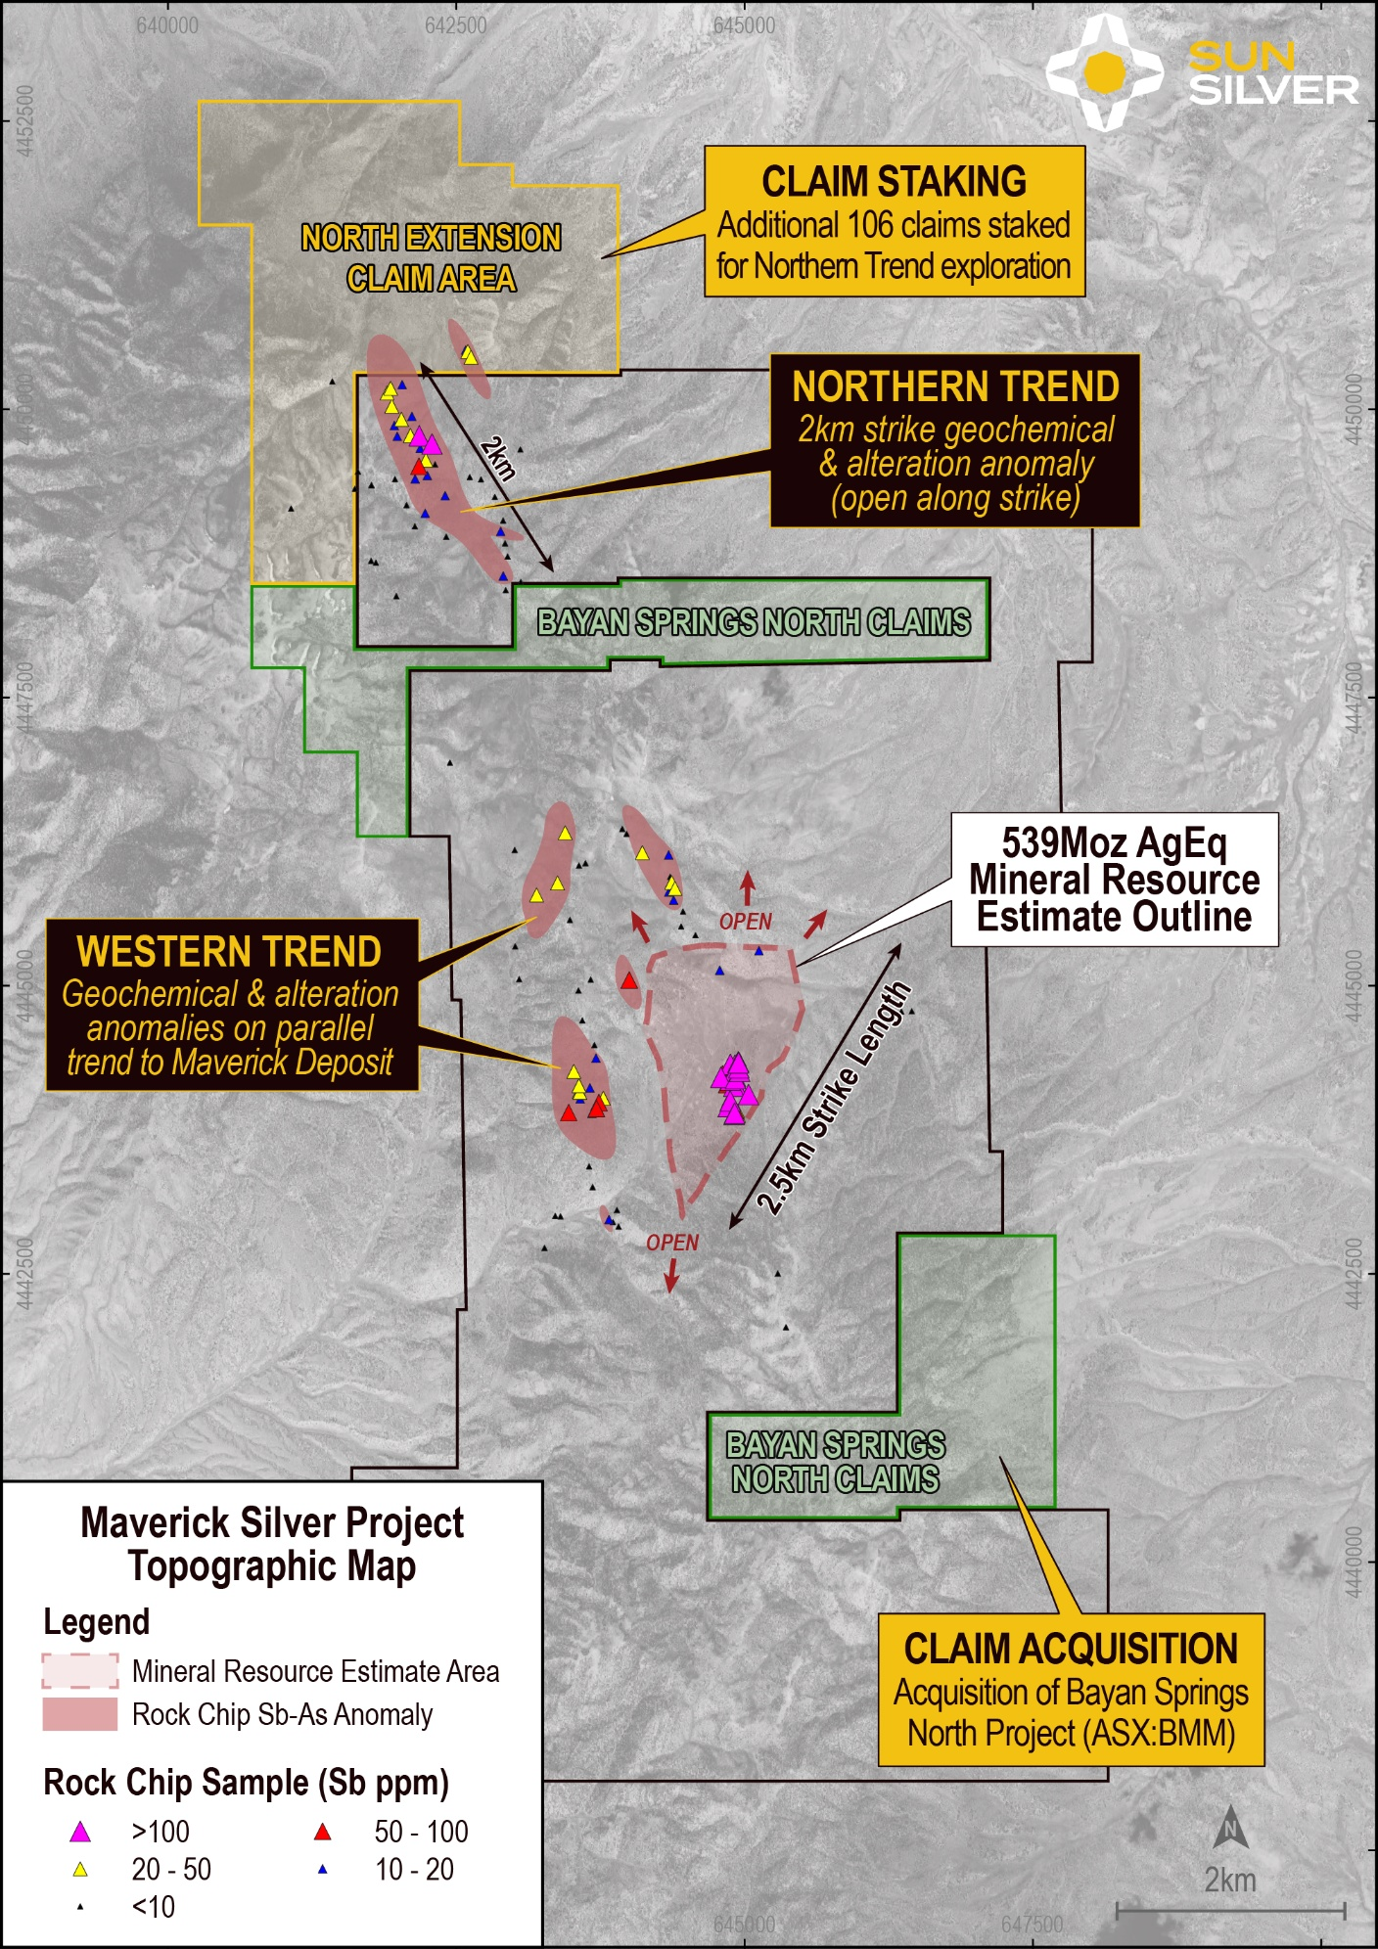
MAVERICK SILVER STRATEGIC LAND CONSOLIDATION
CONTINUOUS OWNERSHIP OF 15KM MAVERICK SILVER TREND
100% Acquisition of Bayan Springs North Project plus 106 additional lode claims staked.
Consolidates continuous ownership across an emerging 15km trend.
Only ~2.5km of strike drill tested, leaving significant exploration upside.
Defined new northern target exhibiting elevated arsenic and antimony pathfinder geochemistry, characteristics or Carlin-style mineral systems.
Pathfinder geochemistry mirrors the existing Maverick Silver Deposit, supporting the potential for a significantly larger mineralised system along the northwest corridor.
For previously reported rock chip samples refer to the Company’s ASX announcement dated 23 July 2026
13

Slide 14
GROWTH VIA CONSOLIDATION, RESOURCE GROWTH & ASSET CONFIDENCE
 | Q3 2026 | Q4 2026 | Q1 2027 | Q2 2027 | Q3 2027 | Q4 2027 | Q1 2028
Resource Extensional Drilling
Infill Drilling
Target Resource Updates
Metallurgical Testwork
Internal Studies
Scoping Study / PEA
Targeted Market Release – Scoping Study
Environmental Baseline Survey’s
Preliminary Feasibility Study (PFS)
Targeted Market Release – PFS
Mine Development Permitting
*The timetable is indicative and subject to change.
14

Slide 15
Thank You
Contact Information: Andrew Dornan Managing Director A: 288 Railway Parade, West Leederville, WA, 6007 W: sunsilver.com.au E: info@sunsilver.com.au | Investor Relations: Nicholas Read Read Corporate T: +61 (08) 9388 1474 E: nicholas@readcorporate.com.au

Slide 16
Appendix A – Maverick Silver Project Mineral Resource Estimate
Classification | Cut-off (g/t AgEq) | Tonnes (Mt) | AgEq (Moz) | AgEq (g/t) | Ag (Moz) | Ag (g/t) | Au (Moz) | Au (g/t)
Inferred | 30 | 237.3 | 539 | 71 | 347.2 | 45.5 | 2.25 | 0.30
Maverick Silver Project Mineral Resource estimated in accordance with the Australasian Code for Reporting of Exploration Results, Mineral Resources and Ore Reserves (JORC Code).
Refer to the Company's ASX announcement dated 9 December 2025 for further details regarding the Maverick Silver Project Mineral Resource (Original Announcement). New metallurgical test work reported 5 March 2026 is a modifying factor in resource estimation, but the preliminary results reported above do not materially affect the mineral resource estimate in respect to metal equivalent calculations due to the similar recovery of both gold and silver. The Company confirms that it is not aware of any new information or data that materially affects the information contained in the Original Announcement and that all material assumptions and technical parameters underpinning the mineral resource estimate continue to apply and have not materially changed.
References to metal equivalents (AgEq) are based on an equivalency ratio of 85, which is derived from a gold price of USD$2,433 and a silver price of USD$28.50 per ounce, being derived from the average monthly metal pricing for the last three years, and average metallurgical recovery. This is calculated as follows: AgEq = Silver grade + (Gold Grade x ((Gold Price * Gold Recovery) / (Silver Price * Silver Recovery))) i.e. AgEq (g/t) = Ag (g/t) + (Au (g/t) x ((2433 x 0.85) / (28.50 x 0.85))). Metallurgical recoveries of 85% have been assumed for both silver and gold. Preliminary metallurgical recoveries were disclosed in the Company’s prospectus dated 17 April 2024, which included a review of metallurgical test work completed by the prior owners of Maverick Silver Project. Metallurgical recoveries for both gold and silver were recorded in similar ranges, with maximum metallurgical recoveries of up to 97.5% in preliminary historical metallurgical testing in respect of silver and up to 95.8% in respect of gold. Gold recoveries were commonly recorded in the range of 80% - 90%, and the midpoint of this range has been adopted at present in respect of both silver and gold. New preliminary metallurgical results reported 5 March 2026 demonstrate similar recoveries for Au (74%) and Ag (77%) from IBR tests, and 82.15% Au and 87.25% Ag recovery from cyanide leach tests, which would not materially affect the metal equivalent ratio and stated resource estimate. It is the Company’s view that both elements referenced in the silver and gold equivalent calculations have a reasonable potential of being recovered and sold..
16

